Slide 1
CULT 100-001 Media & Popular Cultures in Global Context
Winter 2019 Term 1
Tuesday and Thursday
11:00am-12:20pm
EME-2181

Slide 2
INSTRUCTOR & TA INFORMATION
TEACHNG ASSISTANT
INSTRUCTOR
Dr. ALIFA BANDALI
Office hours: Friday 2:30-3:30pm, or by appointment
Location: CCS 381
Email: alifa.bandali@ubc.ca
Please indicate “CULT 100” in subject line and wait 48 hours to receive a response.
Mehnaz Tabassum
Office Hours: By appointment
Email: mehnazt@mail.ubc.ca
Please indicate “CULT 100” in subject line and wait 48 hours to receive a response

Slide 3
SEPT 17 OUTLINE
Reminders & Announcements
Review: Kellner Reading and Critical Reading Practices
Popular Culture in Historical Context
Next Class: Producing Media Culture

Slide 4
REMINDERS & ANNOUNCEMENTS

Slide 5
THE LEARNING HUB – Now Open
Website link: https://students.ok.ubc.ca/academic-success/learning-hub/

Slide 6
TRUTH AND RECONCILIATION COMMITMENT CEREMONY
Tuesday, September 24, 2019
Hallisey Atrium (EME building)
3:30-5:30 pm
*Will be live streamed as well
RSVP link: https://ceremonies.ok.ubc.ca/rsvp-online/trc/

Slide 7
REMINDER: STUDENT NAME CARDS
For those of you who are just joining us:
Please fold the sheet paper horizontally to create a name tag to display in front of you.
PRINT YOUR PREFERRED NAME IN LARGE BLOCK LETTERS on your name tag. You are welcome to indicate your preferred gender pronouns.
Please keep your name tag with you and display it during every class so that Dr. Bandali and your peers can learn your names. Thank you!

Slide 8
REVIEW: KELLNER READING AND CRITICAL READING PRACTICES

Slide 9
CRITICAL READING PRACTICES
6. The main assumption(s) underlying the author’s thinking are…

Slide 10
CRITICAL READING PRACTICES
6. The main assumption(s) underlying the author’s thinking are…
The author assumes that readers are somewhat familiar with advanced theoretical terms and concepts (addressing an audience of interdisciplinary scholars)
The author assumes that readers are interested in achieving social and political justice

Slide 11
CRITICAL READING PRACTICES
6. (a) If we take this line of reasoning seriously, the implications are…

Slide 12
CRITICAL READING PRACTICES
6. (a) If we take this line of reasoning seriously, the implications are…
That we will endorse or support the project of (Critical) Cultural Studies

Slide 13
CRITICAL READING PRACTICES
6. (b) If we fail to take this line of reasoning seriously, the implications are…

Slide 14
CRITICAL READING PRACTICES
6. (b) If we fail to take this line of reasoning seriously, the implications are…
That we take for granted or dismiss the relevance of Cultural Studies as a valid academic discipline and field of study

Slide 15
CRITICAL READING PRACTICES
7. The main conclusions in this chapter are…

Slide 16
CRITICAL READING PRACTICES
7. The main conclusions in this chapter are…
Cultural Studies is part of a critical pedagogy (a form of teaching) that can empower people to struggle for alternative cultures and political change

Slide 17
REVIEW: WHY STUDY POPULAR CULTURE?
Cultural studies is necessarily political because it is concerned with the distribution of social and economic power in the world
“There is something at stake in cultural studies, in a way that I think, and hope, is not exactly true of many other very important intellectual and critical practices.” (Hall as cited in the textbook)
Cultural studies helps us understand how popular culture operates and draws us in as producers and consumers who work to literally reshape the world

Slide 18
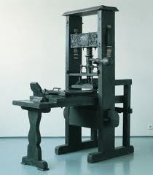
POPULAR CULTURE IN HISTORICAL CONTEXT
Required reading:
O’Brien, Susie and Imre Szeman. (2018). “Chapter 2: The History of Popular Culture.”

Slide 19
WHAT QUESTIONS DOES THE CHAPTER EXPLORE?
How is contemporary popular culture different from what came before?
What factors – economic, social and political contributed to the development of popular culture as we know it today?
How is the development of popular culture tied to the broader history of the disappearance of public space?
How are the relationships of power such as class and gender mediated through culture?

Slide 20
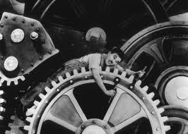
INDUSTRIAL REVOLUTION
Refers to a period in British history from approximately the mid-18th to mid-19th century with the rise of capitalism and liberal democracy
Describes transition from agricultural life (farm work) to mechanical life (factory work)

Slide 21
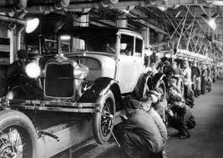
INDUSTRIAL REVOLUTION
During this period, the nature of people’s work (labour) changed significantly
Human labour became detached (alienated) from the larger process of production (Fordism)
Implementation of master and servant laws and poor laws
See Charles Chaplin’s critique in Modern Times (1936):
https://youtu.be/a-FbVF1x1_U

Slide 22
Modern Times Clip
QUESTIONS:
What did you notice about Chaplin’s working environment?
Is it highly regulated or controlled?
What are some of the ways in which you saw workplace disciplinary tactics in use?

Slide 23
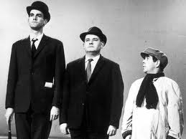
INDUSTRIAL REVOLUTION
Working class people struggled to define their lives on their own terms, which included labour and recreation
Created opportunities for class mobility
Growth of a new middle-class population (with leisure time and disposable incomes)

Slide 24
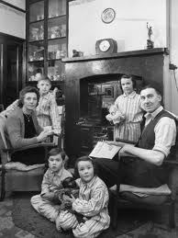
INDUSTRIAL REVOLUTION
Created distinction between work and home spheres (i.e., public vs. private)
Promoted middle-class values and the significance of the nuclear family, moral discipline, and social conformity (rational recreation)

Slide 25
ACTIVITY: Think, Pair, Share
Take 1 minute to think about and write down the characteristics of a typical nuclear family:
How many family members are there?
Who are they?
Where do they live?
What are their occupations?
Find a partner and share your answers. Discuss:
Is it still a common family structure? Is it still a desired family structure? Why or why not?

Slide 26
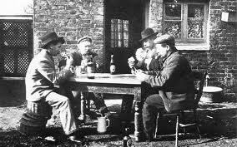
INDUSTRIAL REVOLUTION
Popular culture is a terrain of class struggle (e.g., pubs vs. evening classes, music halls vs. libraries, sporting papers vs. classic literature)
Popular culture becomes increasingly commercialized and escapist in nature

Slide 27
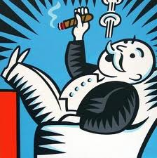
CAPITALISM
Refers to the dominant economic system in the world today that has developed since the 15th c.
Note: the current economic period is sometimes referred to as advanced capitalism

Slide 28
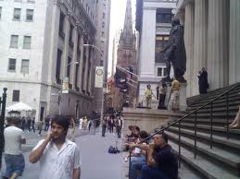
CAPITALISM
In capitalist economies, the means of creating, distributing and exchanging wealth lie mainly in the hands of individuals and corporations (not the public or state)

Slide 29
CAPITALISM
The main goal of individuals and corporations in capitalism is to maximize wages or profit
The value of goods and human labour is not defined by social usefulness or significance but by how much they can be exchanged for

Slide 30
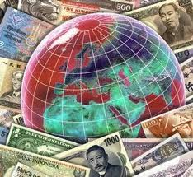
CAPITALISM
Characterized by individualism, competition, wage labour, and profit-making, or the imperative of economic growth, which are often considered positive and desirable aspects of liberal democratic societies

Slide 31
INDIVIDUALISM
The doctrine that the interests of the autonomous, unique individual (a single human being in a social group) should be most important
A key aspect of liberal democratic societies

Slide 32
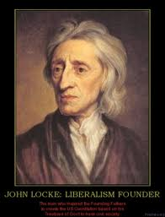
LIBERALISM
18th c. Euro-Western philosophy resting on ideas of individual rights and responsibilities to the state
A belief that the state will provide equality for all citizens

Slide 33
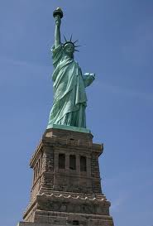
LIBERAL DEMOCRACY
Political philosophy that emphasizes political and civil freedoms based on notions of individualism
The belief that, under a liberal state, all humans are equal and “free” to participate in the public sphere and choose their own destiny

Slide 34
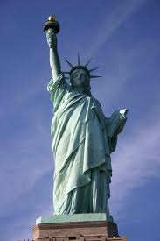
ECONOMIC LIBERALISM
Western political philosophy that holds individualism as the key to organizing the economy
Emphasizes private property rights, the role of market forces, and non-interference by the state or government

Slide 35
CAPITALISM
Proponents think that the economic laws of supply and demand lead to optimal and efficient (fair?) distribution of goods and services
Detractors draw attention to how capitalism promotes a growing gap between the rich and the poor whereby poor people’s lives are organized to generate more wealth for those at the top

Slide 36
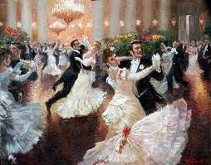
CAPITALISM
In capitalism’s early stages, the colonial exploitation of land, resources, and non-European slave labour made possible the massive accumulation of wealth enjoyed by a relatively small percentage of Europeans

Slide 37
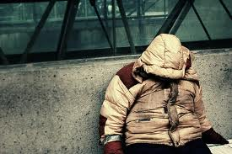
CAPITALISM
The negative effects of capitalism include social fragmentation, unequal distribution of wealth, and the conversion of everything including life itself into something that can be bought and sold

Slide 38
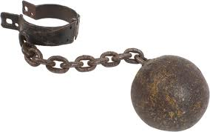
CAPITALISM
The most brutal effects of capitalism including slavery or forced labour intensified during European colonialism (17-19th c.) and the Industrial Revolution

Slide 39
CAPITALISM
The common tendency is to see capitalism as a natural, inevitable, and permanent organization of social and economic life
Capitalism is not the only economic system that has ever been in place
It is not likely to be the last way in which human beings organize their economies

Slide 40
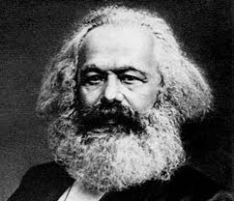
IDEOLOGY
The process by which values and beliefs in a society become naturalized and common-sense
The social and political processes that work to obscure history and make everyday life seem natural, inevitable and unchangeable
Karl Marx used this concept to explain why most people did not question the workings of capitalism

Slide 41
CLASS
Describes a material relationship to the wealth-generating structures of society i.e., class distinguishes owners from labourers
According to Marx, class greatly influences one’s identity and social orientation

Slide 42
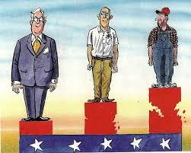
CLASS CONSCIOUSNESS
Recognition that the role of class greatly determines a person’s social orientation (i.e., interests, behaviours, attitudes)
To be class conscious is to be aware that capitalism is an ideology

Slide 43
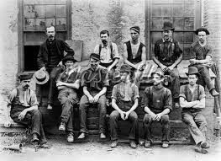
WORKING-CLASS CONSCIOUSNESS
A political awareness that developed in the 19th c. for worker solidarity and democratic rights (collectivism)
Expressed through distinct but masculinist cultural forms including sport, games, conversation, eating, drinking, songs, sketches, poetry

Slide 44
SUMMARY OF MAIN POINTS
The British Industrial Revolution transformed practices of work and leisure, destroying old forms of culture and making new ones possible
Popular culture has been shaped by working-class activism, middle-class reform, and economic liberalism
Popular culture both reflects and shapes ongoing struggles about the meaning of freedom and democracy

Slide 45
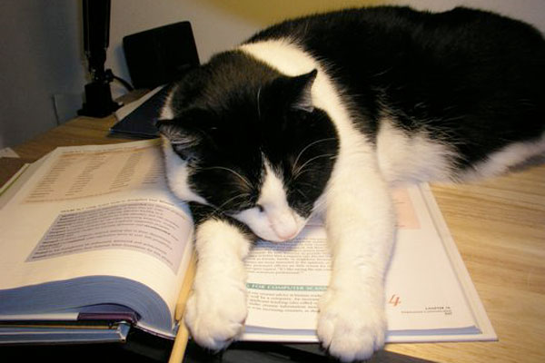
NEXT CLASS: Thursday, September 19 Producing Media Culture
Read Chapter 4 in your textbook (we will read Chapter 3 in a couple of weeks)
Consider the following question:
What is “culture industry”?

