Slide 1
Performance Evaluation Lecture 10
FINC3017 INVESTMENTS AND PORTFOLIO MANAGEMENT
DR DANIKA WRIGHT

Slide 2
UoS announcements
Essay marking underway
Final exam information posted on Canvas
Start your study early!
Practice questions: a study aide to self-assess your understanding
Do not rote learn answers! If you understand the concepts and models you will be better placed to answer new questions on the exam

Slide 3
RQ1: Utility theory
Danika does not like the rain. She prefers to be dry. However, carrying an umbrella is a burden. The table below outlines the probability of two states (rainy or not rainy), and her resulting utility in the event that she either takes or leaves behind her umbrella.
Will Danika take or leave behind her umbrella tomorrow? (Assume she is a rational, utility maximiser.)
What is the maximum probability of a rainy day that would make Danika indifferent between taking or leaving her umbrella
 | State
 | Rainy (p = 0.6) | Not rainy (p = 0.4)
Take umbrella | U = 9 (burdened but dry) | U = 9 (burdened but dry)
Leave umbrella | U = 0 (wet ☹ ) | U = 12 (unburdened and dry ☺ )

Slide 4
RQ1(a) answer
EU(take) = 0.6*9 + 0.4*9 = 9
EU(leave) = 0.6*0 + .4*12 = 4.8
EU(take) > EU(leave)
She will take the umbrella

Slide 5
RQ1(b) answer
To be indifferent need EU(take) = EU(leave)
EU(take) = 9, regardless of p
Therefore, solve for EU(leave) = 9
9 = p.0 + (1-p)12
9 = 12-12p
12p = 3
p = 0.25
25% chance of rain is the probability that makes her indifferent between taking the umbrella or leaving it

Slide 6
RQ2: Utility
In 2010, Danika has total wealth of $50,000 and invested half of her money in risky assets. Today, Danika has total wealth of $150,000 and still invests half of her money in risky assets. Danika has _________ absolute risk aversion and __________ relative risk aversion:
decreasing; increasing
increasing; increasing
increasing; constant
decreasing; decreasing
decreasing; constant

Slide 7
RQ2 answer
Danika has decreasing absolute risk aversion and constant relative risk aversion
ARA is how the amount invested in risky assets changes as wealth increases
Wealth increasing and amount invested in risky assets increasing is decreasing absolute risk aversion
RRA is how the percentage of wealth invested in risky assets changes as wealth changes
Wealth increasing and same proportion invested in risky assets indicates constant RRA

Slide 8
RQ3: Portfolio optimisation
The capital allocation line is also the __________.
investment opportunity set formed with a risky asset and a risk-free asset
investment opportunity set formed with two risky assets
line connecting all portfolios that offer the same utility to a particular investor
line connecting all portfolios with the same expected rate of return and different standard deviations
line showing the equilibrium relationship between beta and expected returns for all portfolios
Chart and define each of the above items

Slide 9
RQ3 answer
Multiple choice: A
B is the feasible investment set
C is the indifference curve
D is an indifference curve for a risk neutral investor
E is the security market line

Slide 10
Performance Evaluation Lecture 10
FINC3017 INVESTMENTS AND PORTFOLIO MANAGEMENT
DR DANIKA WRIGHT

Slide 11
Learning objectives
How can we assess the performance of different investment managers?
There are a large number of metrics available
Can investment managers select the best assets or can they time the market?
These are two sources of investment manager skill
Why does style matter when evaluating fund performance?
We need a fair comparison between funds of different styles
Show how we can decompose fund performance to identify how the fund generate its performance - performance attribution
Reading
BKM Ch. 24

Slide 12
Why measure performance?
The managed funds industry places an emphasis on performance measures
Examples include:
The star ratings of Morningstar
The publication of league tables
Statistics and rankings of funds based on past performance that are regularly carried by the Australian Financial Review and Personal Investment
Performance measurement allows us to assess the skill of fund managers
Is the return a managed fund provides reflective of skill or just the risk that a manager has been exposed to?

Slide 13
Past performance
Past information is typically regarded as an important input in investment decisions
Australian Securities and Investments Commission (ASIC) revealed that past performance is included in 70% of commercial advertisements
Of these, 65% report past performance figures based on only one year of prior data
Empirical research has found that past performance correlates with future fund flows
Sirri and Tufano (1998) found that investors are attracted to good performers in the USA
Sawicki (2000) and Frino, Heaney and Service (2005) found similar results for the Australian market

Slide 14
ASIC Regulatory Guide 53
“Past performance information is used frequently in investment-related promotional material and it is therefore important that it is used appropriately.”
In summary, promotional material must not be misleading
For example:
is misleading if most of the other ABC funds underperformed the five-year sector median
Promotional material that relates to past performance needs to specify that past performance will not necessarily be repeated, e.g.:
https://asic.gov.au/regulatory-resources/find-a-document/regulatory-guides/rg-53-the-use-of-past-performance-in-promotional-material/

Slide 15
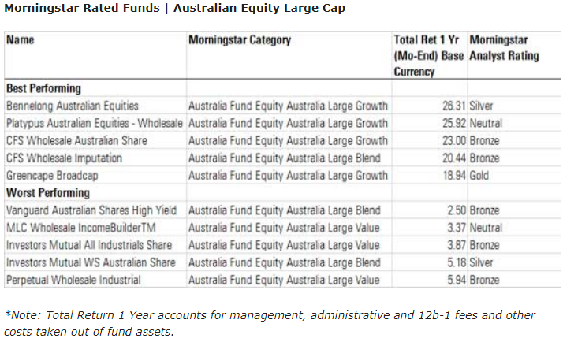
Morningstar: Best/worst equities funds
https://www.morningstar.com.au/funds/article/5-best-and-worst-performing-equity-funds-of-f/169076
Bennelong summary: https://www.morningstar.com.au/Funds/FundReport/16998

Slide 16
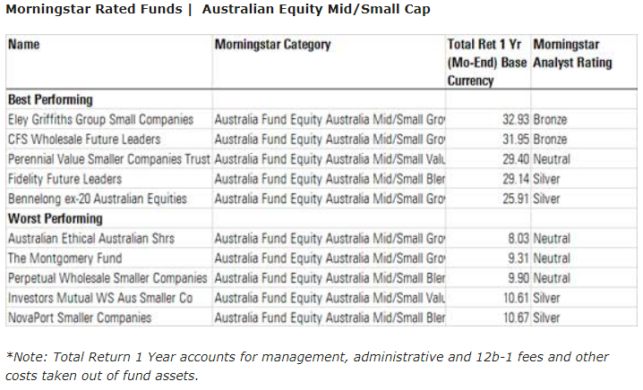
Morningstar: Best/worst equities funds

Slide 17
The Performance Evaluation Menu

Slide 18
Index benchmarks
Comparisons are made to a pre-selected benchmark portfolio, which is typically an index (e.g. S&P/ASX 200 or 300)
The benchmark is related to the fund objective
Success of passive managers is measured by the standard deviation of active return, otherwise known as tracking error (TE):
where:
R_{p,t} = portfolio return over time period t
R_{b,t} = benchmark return over time period t

Slide 19
Active return (fund return – benchmark return)

Slide 20
Adjusting returns for risk
A simple way to adjust returns for risk is to compare the portfolio’s return with the returns on a comparison universe
The comparison universe is a group of funds or portfolios with similar risk characteristics, such as growth stock funds or high-yield bond funds
Let’s examine Australian equity funds that are classified as Large Blend
 | 3-month | 1-year | 2-year | 3-year | 5-year
Min | -6.37 | -12.81 | -6.49 | -11.22 | -6.43
25th Percentile | 3.03 | -7.53 | -0.08 | 3.07 | 4.61
Median | 4.56 | -5.99 | 1.63 | 4.37 | 5.59
75th Percentile | 6.06 | -3.87 | 2.97 | 5.33 | 6.49
Max | 22.87 | 18.66 | 22.56 | 16.49 | 12.15
Schroder Equity Opportunities | 13.72 | -5.19 | 1.76 | 5.35 | 8.13

Slide 21
Risk-adjusted performance: Sharpe ratio
Sharpe ratio:
= Average return on the portfolio
= Average risk free rate
= Standard deviation of portfolio return
Where have you seen this before?
It is the slope of the capital allocation line
The benchmark value is the Sharpe index for the market
It does not rely on an asset pricing model
It captures jointly aspects of return and risk

Slide 22
Risk-adjusted performance: Treynor measure
Treynor measure :
= Average return on the portfolio
= Average risk free rate
= Beta of portfolio
Where have you seen this before?
It is the slope of the security market line
Superior performance indicated where the Treynor index exceeds the market risk premium (MRP)
Problems include correct value of MRP, the need to estimate beta, and the appropriateness of CAPM

Slide 23
Risk-adjusted performance: Jensen’s alpha
Jensen’s alpha uses data of a given frequency (t) to estimate a regression
R_{p} = Return on the portfolio
β_{p} = Beta of portfolio
R_{f} = Risk free rate
R_{m} = Return on market index portfolio
Jensen’s alpha relies upon the security market line and the CAPM being the correct model
If a fund is performing to expectations (relative to the CAPM) then α would be zero
Superior performance is indicated positive α while under-performance negative α

Slide 24
Risk-adjusted performance: Information ratio
The information ratio
i.e. how much return was generate from diversifiable risk?
The information ratio is sometimes referred to as:
R_{b} is the return on the benchmark
Values close to 1 indicate good performance

Slide 25
Example: Portfolio performance
 | RXK Defensive | BGT Super Growth | Market
Beta | 0.90 | 1.60 | 1.00
Excess Return | 11% | 19% | 10%
Alpha | 2% | 3% | 0%
Is RXK better than BGT?

Slide 26
Example: Portfolio performance
 | RXK Defensive | BGT Super Growth | Market
Beta | 0.90 | 1.60 | 1.00
Excess Return | 11% | 19% | 10%
Alpha | 2% | 3% | 0%
Treynor | 12.2 (=11/0.9) | 11.8 (=19/1.6) | 10 (= 10/1)
RXK has highest Treynor, but lower alpha
How is this possible
Which investment is better?

Slide 27
Which measure is appropriate?
It depends on investment assumptions
If the portfolio represents the entire risky investment, then use the Sharpe measure
If the portfolio is one of many combined into a larger investment fund, use the Jensen or the Treynor measure
The Treynor measure is appealing because it weighs excess returns against systematic risk

Slide 28
Example: Performance statistics
If P or Q represents the entire investment, Q is better because of its higher Sharpe measure
If P and Q are competing for a role as one of a number of subportfolios, Q also dominates because its Treynor measure is higher
If we seek an active portfolio to mix with an index portfolio, P is better due to its higher information ratio
Measure | P | Q | Mkt
Sharpe Ratio | 0.45 | 0.51 | 0.19
Alpha | 1.63 | 5.28 | 0.00
Beta | 0.69 | 1.40 | 1.00
Treynor Index | 4.00 | 5.40 | 1.63
Information Ratio | 0.84 | 0.59 | 0.00

Slide 29
Sortino ratio
A limitation of some performance evaluation measures, such as the Sharpe ratio, is that both downside and upside risk are penalized
The Sortino ratio aims to address this issue by only penalizing the downside deviation
It is a modification of the Sharpe ratio, and requires determination of a minimum acceptable return (MAR), or target required return, T
$$Sortino= \frac{\overline{R_{p}}−T}{{SD}_{p}}$$
Where SD_{p} is the semi-deviation, or downside deviation
When returns are symmetrically distributed, the results from Sortino and Sharpe are similar. Skewness however can lead to very different results, so Sortino ratio is important for hedge fund evaluation (more next week)

Slide 30
Market timing

Slide 31
Market timing
In its pure form, market timing involves shifting funds between a market-index portfolio and a safe asset
Treynor and Mazuy:
A positive value of α_{p} is indicative of superior stock selection performance
A positive value for Ψ_{p} indicates superior market timing ability

Slide 32
Market timing
Merton (1981) defines market timing as performance relative to risk-free rate
Managers can switch between equity and bonds, so portfolio return is comprised of a return on the equity market plus a put option on the equity market
Option is valuable when equity return falls below risk-free rate:
Positive values of φ_{p} indicate market timing ability

Slide 33
Break-time practice

Slide 34
RQ4: Optimal portfolios
You have $500,000 available to invest. The risk-free rate as well as your borrowing rate is 8%. The return on the optimal risky portfolio is 16%. Your expected utility is highest at the point where you expect to earn a 22% return, what should you do?
invest $125,000 in the risk-free asset
invest $375,000 in the risk-free asset
invest $500,000 in the risky portfolio
borrow $125,000
borrow $375,000
What effect is an increase in your borrowing rate going to have on your investment position and utility, all else equal? Use a clearly labelled figure to demonstrate your answer.

Slide 35
RQ4 answer
Multiple choice: E
Want: 22% = w16% + (1-w)8%
14 = 8w
w = 1.75 in risky, so -0.75 in risk-free
So, borrow 75% of portfolio
.75*500,000 = $375,000
As a borrower in the first part of the question, utility will decrease and will now borrow less (or possibly cease to be a borrower, depending on the borrowing rate premium)

Slide 36
RQ 5: Sortino ratio
A fund achieves annual returns as presented in the table below
The fund has a target return of 0%. What is the Sortino ratio for this fund?
A competitor fund has a Sortino ratio of 4.020. Which fund performs better using this criterion?
17% | 15% | 23% | -5% | 12% | 9% | 13% | -4%

Slide 37
RQ5 answer
Numerator: average(17, 15, 23, -5, 12, 9, 13, -4) = 10%
Downside deviations: min{17-0,0}, min{15-0,0},min{23-0,0}, min{-5-0,0} = -5%, min{12-0,0}, min{9-0,0}, min{13-0,0}, min(-4-0,0) = -4%
Average squared downside deviations: average(0,0,0,0.25%,0,0,0,0.16%) = 0.0005125
Denominator: sqrt(0.0005125) = 0.0226385
Sortino = 0.1 / 0.0226 = 4.417
Higher Sortino better
Note: the benchmark wont always be zero

Slide 38
The role of style in performance evaluation

Slide 39
Performance evaluation and style
How are the market anomalies that we have discussed in the past few weeks relevant to performance evaluation?
Carhart, M (1997) “On Persistence in Mutual Fund Performance”, The Journal of Finance, Vol. 52, pp. 57-82
RMRF: excess return on market index
SMB: size factor
HML: value factor
PR1YR: 1-year momentum factor

Slide 40
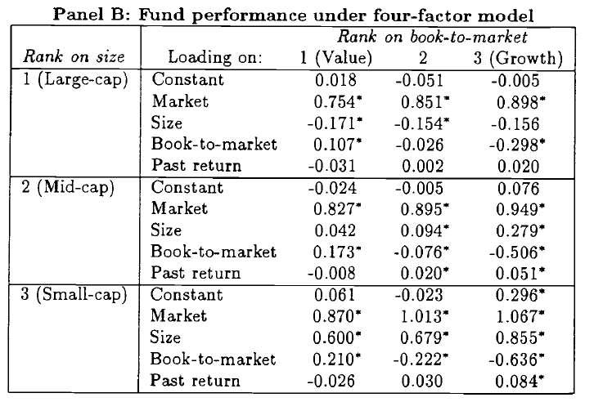
Performance evaluation and style
Chan, Chen and Lakonishok (2002) “On mutual fund investment styles”, Review of Financial Studies, Vol. 15, pp. 1407-1437

Slide 41
Buffett’s alpha
Frazzini, Kabiller and Pedersen (2013) “Buffett’s Alpha”, working paper
http://people.stern.nyu.edu/lpederse/papers/BuffettsAlpha.pdf.
How does Buffett generate such good performance?
Between 1976 and 2011 Berkshire Hathaway has realized a Sharpe ratio of 0.76 compared to market Sharpe ratio of 0.39
Berkshire has a significant alpha to traditional risk factors
A Betting-Against-Beta (BAB) factor and a Quality-Minus-Junk (QMJ) factor seems to explain part of the alpha
“A loading on the BAB factor reflects a tendency to buy safe (i.e., low-beta) stocks while shying away from risky (i.e., high-beta) stocks.”
“A loading on the quality QMJ factor reflects a tendency to buy high-quality companies, that is, companies that are profitable, growing, safe and have high payout “

Slide 42
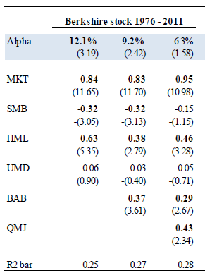
Buffett’s alpha
“Hence, Buffett’s success appears not to be luck.”

Slide 43
Performance Attribution
Where did the outperformance come from?
Decompose relative performance into security selection and asset allocation
Market: Equity, fixed income, alternative investments, etc
Industry: Mining, Financials, Retail, etc
Security: RIO, BHP, FMG, WPL etc
Return on benchmark:
Return on portfolio:
Net return:

Slide 44
Performance Attribution
Total contribution from asset class i
Contribution from asset allocation
Contribution from security selection

Slide 45
Conclusion
Performance evaluation has two key issues
We need a very long observation period to measure performance with any precision, even if the return distribution is stable with a constant mean and variance
What if the mean and variance are not constant? We need to keep track of portfolio changes
But, we need a method that can take account of the risk inherent in portfolios

