Slide 1
Chapter 21
Option Valuation

Slide 2
Chapter Outline
21.1 The Binomial Option Pricing Model
21.2 The Black-Scholes Option Pricing Model
21.3 Risk-Neutral Probabilities
21.4 Risk and Return of an Option
21.5 Corporate Applications of Option Pricing

Slide 3
Learning Objectives
Illustrate the use of the Binomial Option Pricing Model to value an option.
Define the replicating portfolio for the Binomial Option Pricing Model.
Use the Law of One Price to explain how the Binomial Option Pricing Model provides the correct value under the assumptions made by the model.

Slide 4
Learning Objectives (cont'd)
Use the Black-Scholes Option Pricing formula to calculate the value of a call option on a non-dividend-paying stock.
Use the Black-Scholes Option Pricing formula to calculate the price of a European put option on a non-dividend paying stock.
Compute the value of a European option on a dividend-paying stock.

Slide 5
Learning Objectives (cont'd)
Define the Black-Scholes replicating portfolio for a call option on a non-dividend paying stock or a European put option on a non-dividend paying stock.
Discuss what is meant by risk-neutral probabilities, and show how these probabilities can be used to price any other asset for which the payoffs in each state are known.

Slide 6
Learning Objectives (cont'd)
Define and calculate the risk-neutral probability that the stock price will increase in a binomial tree.
Calculate and interpret the beta of an option.
Use the Black-Scholes formula to unlever the equity beta of a firm and find the beta of debt.

Slide 7
A Way to Value Options
Replicating Portfolio
Create a portfolio that replicates the option payoff
The Law of One Price implies that the current value of the option and the replicating portfolio must be equal.
How to replicate the option?
Idea: Call options are like a levered position in a stock
Create a portfolio of a stock and borrowing that has the same payoffs as an option written on the same stock

Slide 8
Binomial Option Pricing
Assume
A European call option expires in one period and has an exercise price of $50.
The stock price today is equal to $50 and the stock pays no dividends.
In one period, the stock price will either rise by $10 or fall by $10.
The one-period risk-free rate is 6%.

Slide 9
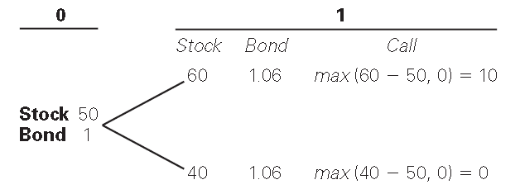
A Two-State Single-Period Model
The payoffs can be summarized in a binomial tree.

Slide 10
A Two-State Single-Period Model (cont'd)
To create the replicating portfolio :Let Δ be the number of shares of stock purchased, and let B be the initial investment in bonds
B will be short position in bonds
Borrowing creates leverage.

Slide 11
A Two-State Single-Period Model (cont'd)
In the up state, the value of the portfolio must be $10.
In the down state, the value of the portfolio must be $0.

Slide 12
A Two-State Single-Period Model (cont'd)

Slide 13
A Two-State Single-Period Model (cont'd)
A portfolio that is long 0.5 share of stock and short approximately $18.87 worth of bonds (at maturity= 18.87 x1.06) will have a value in one period that exactly matches the value of the call.
60 × 0.5 – 1.06 × 18.87 = 10
40 × 0.5 – 1.06 × 18.87 = 0

Slide 14
A Two-State Single-Period Model (cont'd)
By the Law of One Price: The value of the portfolio (the value of 0.5 shares at the current share price of $50, less the amount borrowed is also the call value.
Note that by using the Law of One Price, we are able to solve for the price of the option without knowing the probabilities of the states in the binomial tree, or the expected stock return.

Slide 15
Generalising the Binomial Pricing Formula
Assume
S is the current stock price, and S will either go up to S_{u} or go down to S_{d} next period.
The risk-free interest rate is r_{f} .
C_{u} is the value of the call option if the stock goes up, and C_{d} is the value of the call option if the stock goes down.

Slide 16
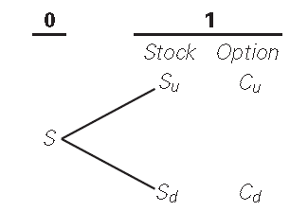
Generalising the Binomial Pricing Formula
d

Slide 17
The Binomial Pricing Formula (cont'd)
Solving the two replicating portfolio equations for the two unknowns Δ and B yields the general formula for the replicating portfolio in the binomial model.
Replicating Portfolio in the Binomial Model
The value of the option is
Option Price in the Binomial Model

Slide 18
Textbook Example 21.1

Slide 19
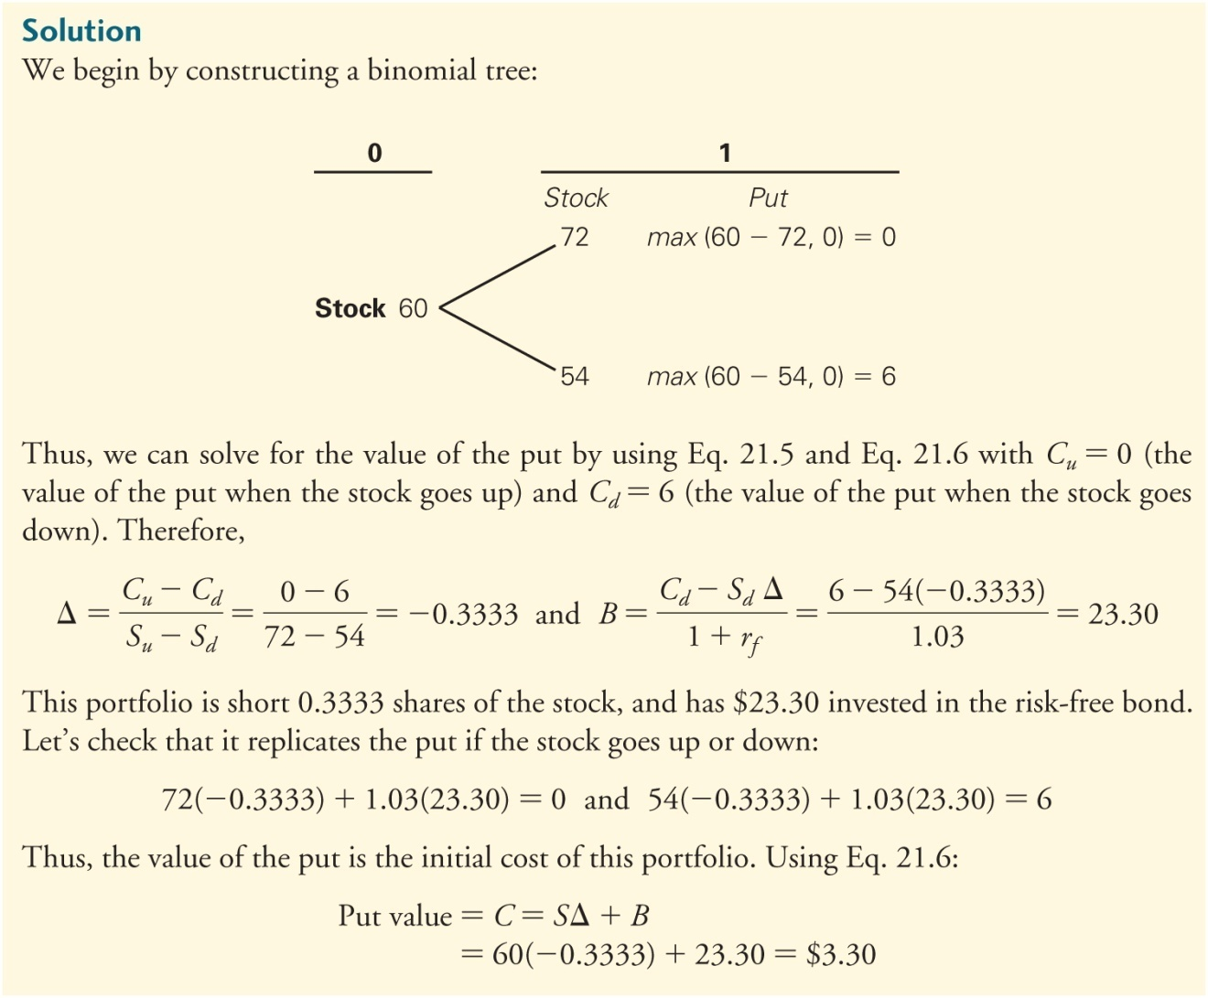
Textbook Example 21.1 (cont'd)
Long
Short

Slide 20
Alternative Example 21.1
Problem
Assume
CLW stock has a current price of $24.
The one-year risk-free rate is 5%.
At the end of one year, CLW will either be trading at $21 or $31.
CLW Inc. does not pay dividends.
What is the price of a European put option that expires in one year and has a strike price of $24?
Notes:
20

Slide 21
Alternative Example 21.1 (cont’d)
Solution
If the stock price rises to $31, the put option will be worthless (max of $24 - $31, $0)
If the stock price falls to $21, the put option will be worth $3 (max of $24 - $21, $0)
Notes:
21

Slide 22
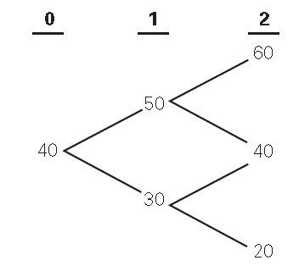
A Multiperiod Model
Assuming just two prices is not realistic, so let us add more
Consider a two-period binomial tree for the stock price.

Slide 23
A Multiperiod Model (cont'd)
To calculate the value of an option in a multiperiod binomial tree, start at the end of the tree and work backward.
At time 2, the option expires, so its value is equal to its intrinsic (exercise) value.

Slide 24
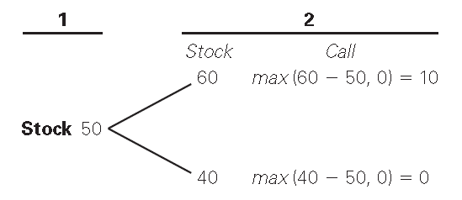
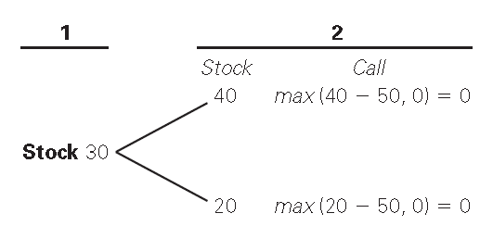
A Multiperiod Model (cont'd)
Call = 6.13 (as first example)
40
Call = 0

Slide 25
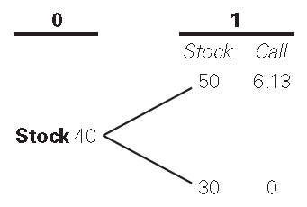
A Multiperiod Model (cont'd)
The final step is to determine the value of the option in each possible state at time 0.
Solving for Δ and B:

Slide 26
A Multiperiod Model (cont'd)
The final step is to determine the value of the option at time 0.
Thus, the initial option value is

Slide 27
A dynamic trading strategy
Underlying the multiperiod binomial model is a dynamic trading strategy.
The hedge ratio and debt quantity change at each step in the binomial tree.
Thus the replicating portfolio is regularly rebalanced.

Slide 28
Textbook Example 21.2

Slide 29
Textbook Example 21.2 (cont'd)

Slide 30
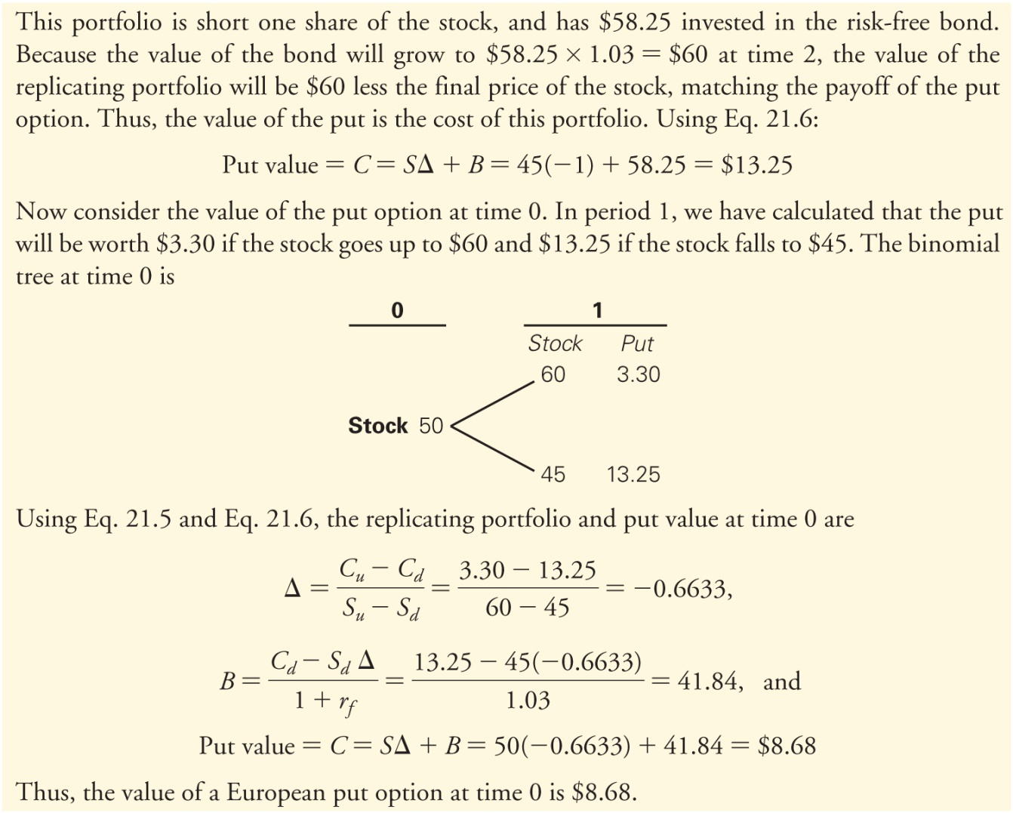
Textbook Example 21.2 (cont'd)

Slide 31
Making the Model Realistic
By decreasing the length of each period, and so increasing the number of steps in the binomial price tree (lattice), the pricing accuracy rapidly increases.

Slide 32
Using the Binomial Model
Simple & very flexible
Much used in practice
How do we get up & down prices?
The usual formulas are:
1+ up-movment% = u =$e^{σ√h}$
1+ down-movment% = d = 1/u = $e^{−σ√h}$
σ = standard deviation of annual returns (continuously compounded)
h = length of time step as a fraction of a year
e = base of natural logarithms
Volatility over the life of the option

Slide 33
21.2 The Black-Scholes Option Pricing Model
Black-Scholes Option Pricing Model
The first and famous option pricing model
Introduced the idea of (dynamic) replicating portfolios to price options
Prices European-style options assuming the stock is traded continuously.
The Binomial Option Pricing Model converges to the Black Scholes as the length of each binomial period shrinks towards zero and the number of periods tends towards infinity.

Slide 34
The Black-Scholes Formula
Black-Scholes Price of a Call Option on a Non-Dividend-Paying Stock
S is the the stock, K is the exercise price, and N(d) is a probability from the cumulative normal distribution
Hedge ratio
Borrowing
Replicating portfolio

Slide 35
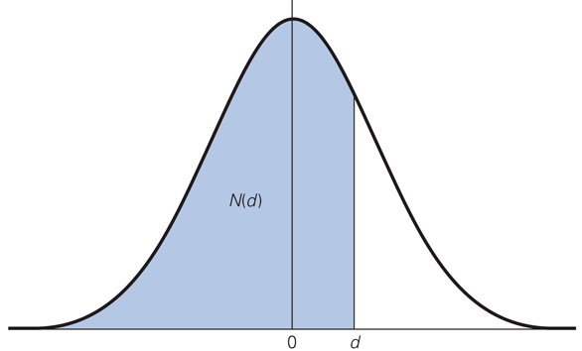
Figure 21.3 Standard Normal Distribution (mean 0, σ =1)
N(d):The probability that an outcome from a standard normal distribution will be below a certain value
Eg p = 0.7
Given d, then N(d) can be found from statistical tables, or use the NORMSDIST(d)
function in Excel

Slide 36
The Black-Scholes Formula (cont'd)
Can be written in a different, but mathematically equivalent way
Where do d₁ and d₂ come from?
Natural logs
Where σ is the annual volatility, and T is the number of years left to expiration
Of the five inputs required ( S, K, r_{f}, T ,σ ) σ is the only one we cannot directly observe
And is relatively easy to estimate compared to the expected return on the stock

Slide 37
Textbook Example 21.3

Slide 38
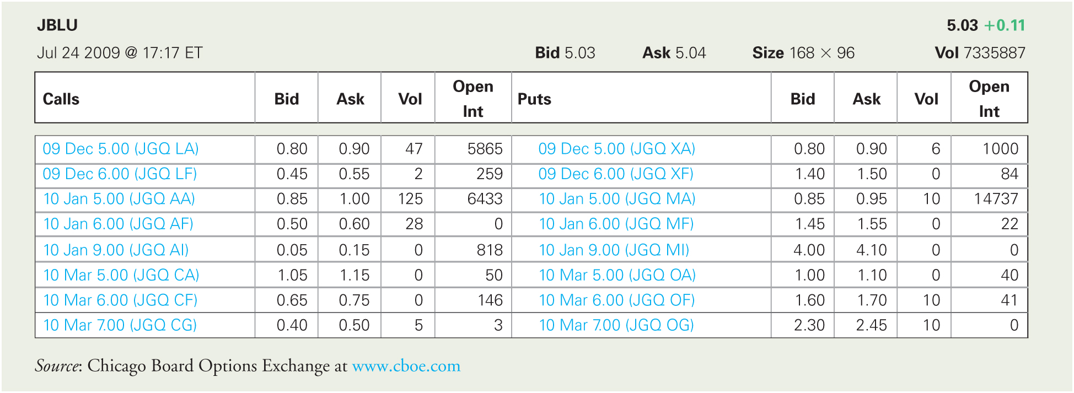
Table 21.1 JetBlue Option Quotes

Slide 39
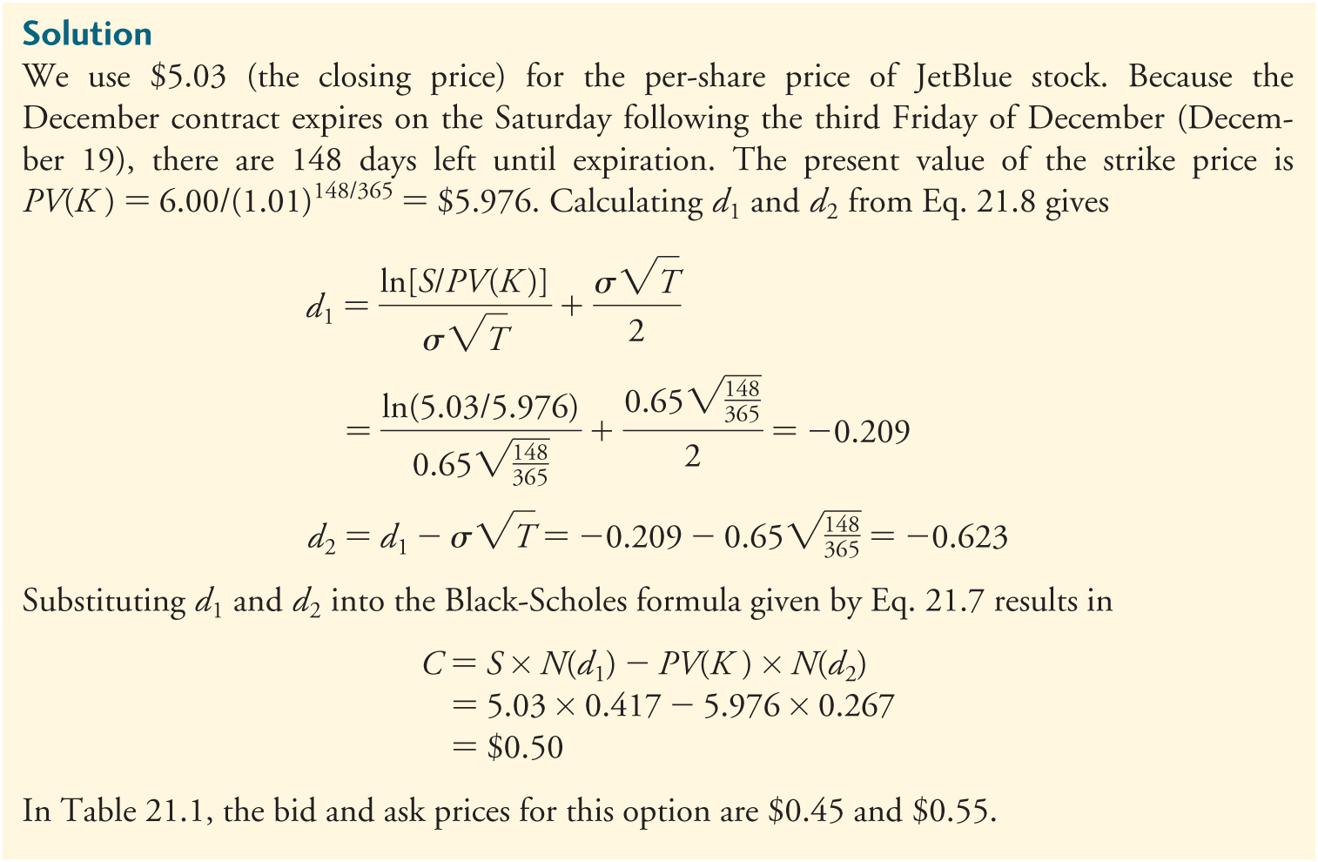
Textbook Example 21.3 (cont'd)

Slide 40
Alternative Example 21.3
Problem
Assume
CLW Inc. does not pay dividends.
The standard deviation of CLW is 45% per year.
The risk-free rate is 5%.
CLW stock has a current price of $24.
Using the Black-Scholes formula, what is the price for a ½ year American call option on CLW with a strike price of $30?
Notes:
40

Slide 41
Alternative Example 21.3 (cont’d)
Solution
Notes:
41

Slide 42
The Black-Scholes Formula (cont'd)
European Put Options a Non-Dividend-Paying Stock
Put call Parity: P = C + PV(K) – S
Substituting the Black Scholes formula for C gives:
Replication of a put by a short position in the stock and lending

Slide 43
Textbook Example 21.4

Slide 44
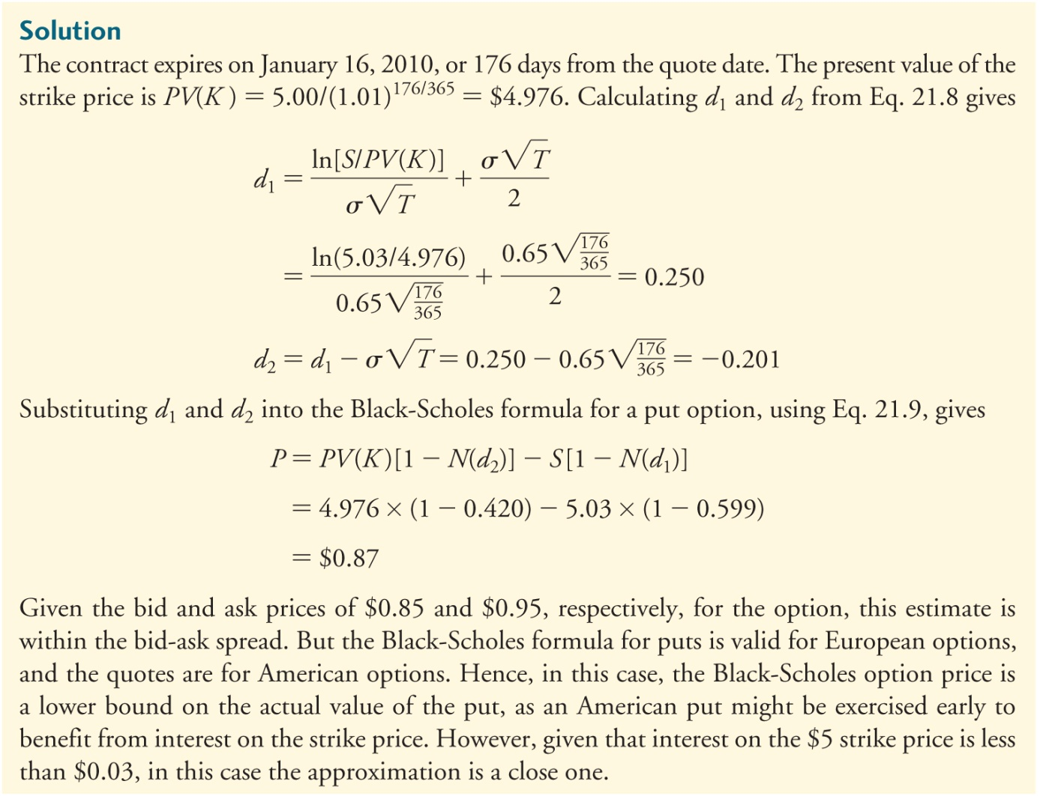
Textbook Example 21.4 (cont'd)

Slide 45
Alternative Example 21.4
Problem
Assume
CLW Inc. does not pay dividends.
The standard deviation of CLW is 45% per year.
The risk-free rate is 5%.
CLW stock has a current price of $24.
Using the Black-Scholes formula, what is the price for a ½ year American put option on CLW with a strike price of $30?
Notes:
45

Slide 46
Alternative Example 21.4 (cont’d)
Solution
Notes:
46

Slide 47
The Black-Scholes Formula (cont'd)
Dividend-Paying Stocks
Option holders don’t get the dividend so they effectively have the right to the value of the stock less the present value of the dividend:
Thus use the Black-Scholes model with S^{x} in place of S.

Slide 48
Textbook Example 21.5

Slide 49
Textbook Example 21.5 (cont'd)

Slide 50
Alternative Example 21.5
Problem
FPA, Inc. has a current stock price of $42.40 per share. The company will pay an annual dividend yield of 6% on its stock. If FPA’s returns have a standard deviation of 25% and the risk-free rate is 4%, what is the value of a one-year call option on the stock with a strike price of $40?

Slide 51
Alternative Example 21.5 (cont’d)
Solution
The price of the call can be found using the Black-Scholes model where the stock price is adjusted for the dividend yield:
Thus,

Slide 52
Implied Volatility
Of the five required inputs in the Black-Scholes formula, only σ is not observable directly.
Practitioners use two strategies to estimate the value of σ.
Use historical data
“Back out” the implied volatility
Implied volatility
The volatility of an asset’s returns that is consistent with the quoted price of an option on the asset

Slide 53
Textbook Example 21.6

Slide 54
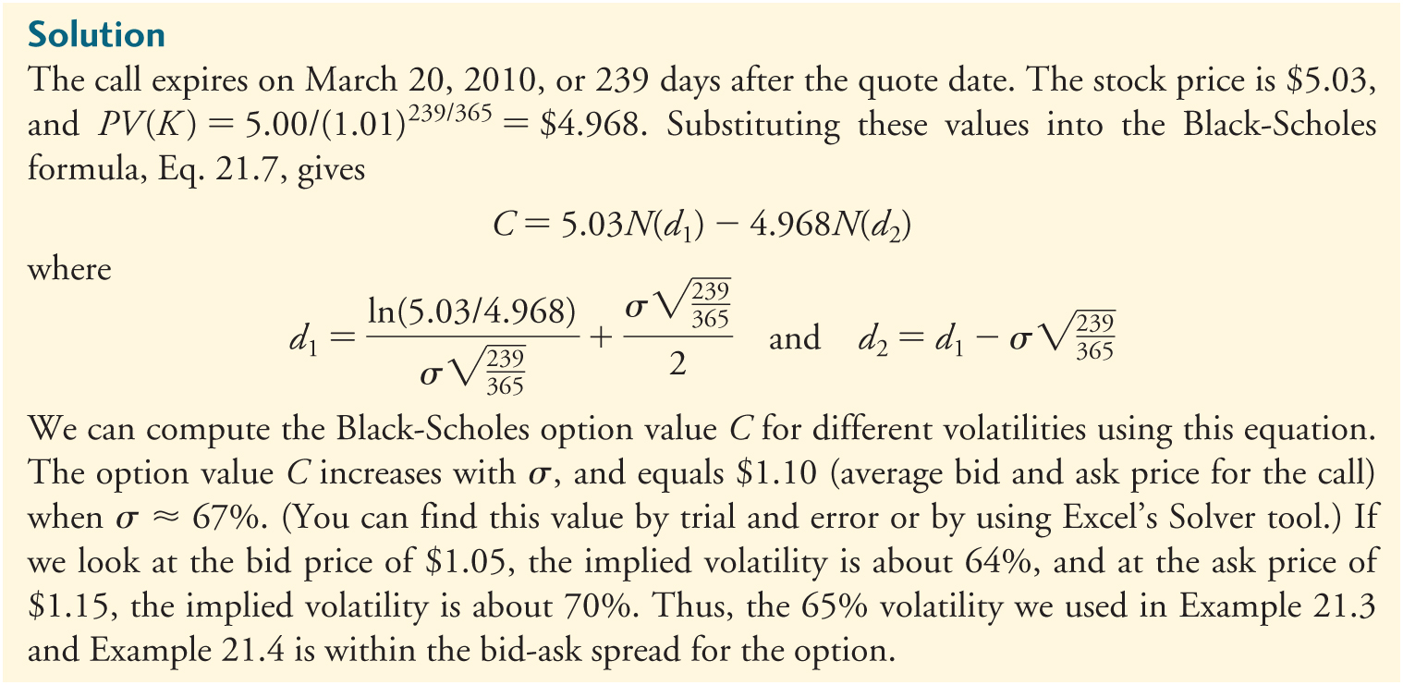
Textbook Example 21.6 (cont'd)
Implied Volatility

Slide 55
21.3 Risk-Neutral Probabilities
If all market participants are risk neutral, then all financial assets (including options) have the same cost of capital, the risk-free rate of interest.

Slide 56
A Risk-Neutral (RN)Two-State Model
Assume a world consisting of only risk- neutral investors, and consider the original two-state example.
The stock price today is equal to $50.
In one period it will either go up by $10 or go down by $10.
The one-period risk-free rate of interest is 6%.

Slide 57
A Risk-Neutral (RN)Two-State Model (cont'd)
If ρ is the RN probability that the stock price will increase, then (1 – ρ) is the RN probability that it will go down.
The value of the stock today must equal the present value of the expected RN price next period discounted at the (risk neutral) risk-free rate.
Solving for ρ yields ρ = 0.65

Slide 58
A Risk-Neutral Two-State Model (cont'd)
The present value of the payoffs to the call option ($10 or $0) is as follows:
As calculated using the binomial method
This is not a coincidence!
Expected value

Slide 59
Implications of the Risk-Neutral World
The binomial model and the Black Scholes model make no assumptions about expected stock returns or investor preferences
So any preferences including risk neutrality and no risk premium are consistent with these models.
But the probabilities computed are not real probabilities, they are risk neutral probabilities that only apply in the risk neutral world.
Higher for bad states & lower for good states

Slide 60
Implications of the Risk-Neutral World (cont'd)
Risk-Neutral Probabilities are also known as State-Contingent Prices, State Prices, or Martingale prices.

Slide 61
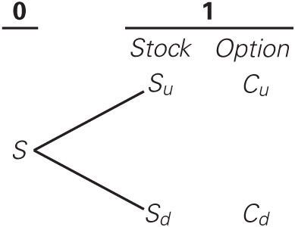
Risk-Neutral Probabilities and Binomial Option Pricing
Consider again the general binomial stock price tree.
Compute the risk-neutral probability that makes the stock’s expected return equal to the risk-free interest rate. Given:
$$S=\frac{p\left(S_{u}\right)+(1−p)\left(S_{d}\right)}{1+r_{f}}$$

Slide 62
Risk-Neutral Probabilities and Option Pricing (cont'd)
Solving for the risk-neutral probability ρ yields:
The value of any option can be calculated by computing its expected payoff using the risk-neutral probabilities, and discounting the expected payoff at the risk-free interest rate.

Slide 63
Textbook Example 21.8

Slide 64
Textbook Example 21.8 (cont'd)

Slide 65
Textbook Example 21.8 (cont'd)

Slide 66
21.4 Risk and Return of an Option
To measure the risk of an option, we can compute the option beta.
This can be accomplished by computing the beta of the replicating portfolio.
Where β_{S} is the stock’s beta and β_{B} is the bond’s beta.
Because the bond is riskless, β_{B} = 0 and the option beta is:
Negative for a call
Δ is +ve for calls and –ve for puts, so option betas are positive for calls and negative for puts

Slide 67
Textbook Example 21.9

Slide 68
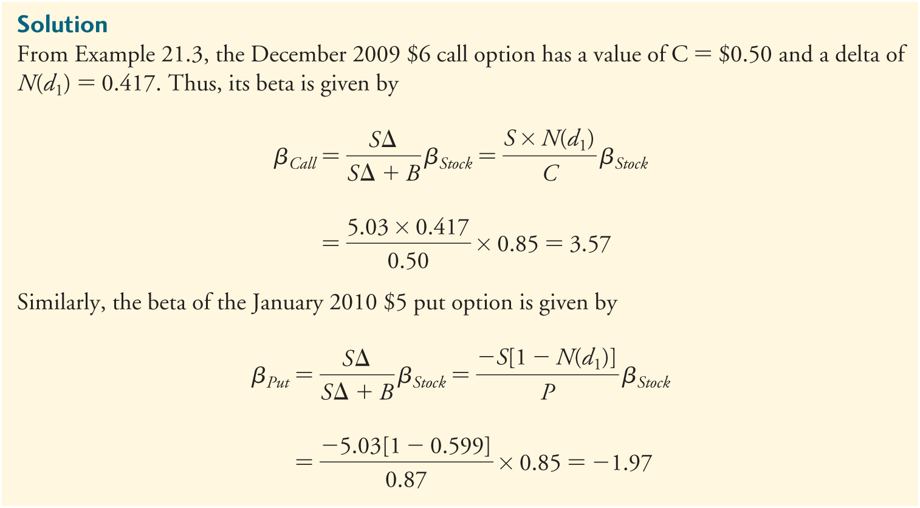
Textbook Example 21.9 (cont'd)

Slide 69
21.4 Risk and Return of an Option (cont'd)
Leverage Ratio
A measure of leverage obtained by looking at debt as a proportion of value, or interest payments as a proportion of cash flows
It is calculated as
SΔ ∕ (SΔ + B)

Slide 70
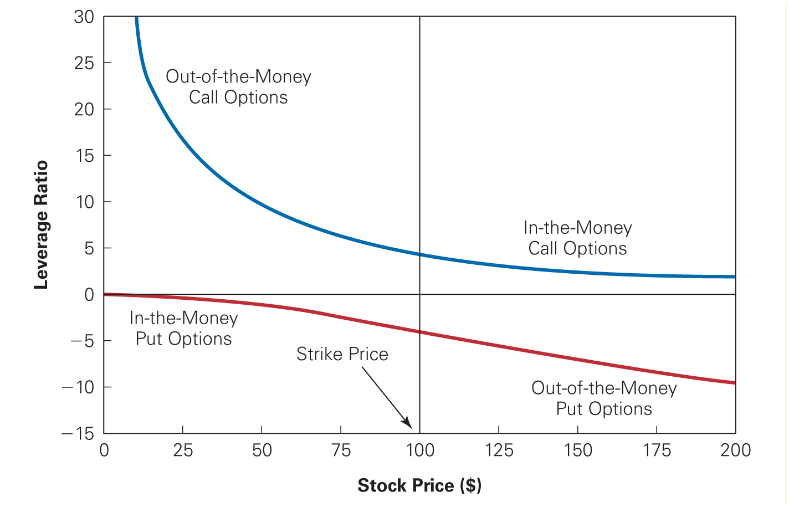
Figure 21.7 Leverage Ratios of Options

Slide 71
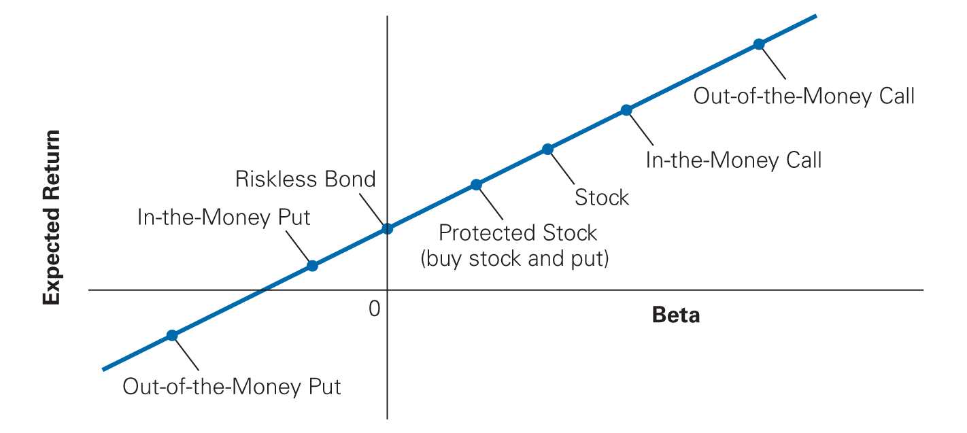
Figure 21.8 Security Market Line and Options

Slide 72
21.5 Corporate Applications of Option Pricing: Levering & Debt Betas
Recall that equity can be viewed as a call on assets
And a call can be replicated by investing in fraction of the asset A (A = D + E) and borrowing B
Thus $E=∆A+B$
Also recall ${ β}_{u}={ E/Aβ}_{E}+D/Aβ_{D}$
Utilising the two equations gives:
${ β}_{E}=∆\left(1+\frac{D}{E}\right){ β}_{u}$
${ β}_{D}=(1−∆)\left(1+\frac{E}{D}\right){ β}_{u}$
Estimating debt beta
Estimate equity beta
Unlever it
Calculate debt beta

Slide 73
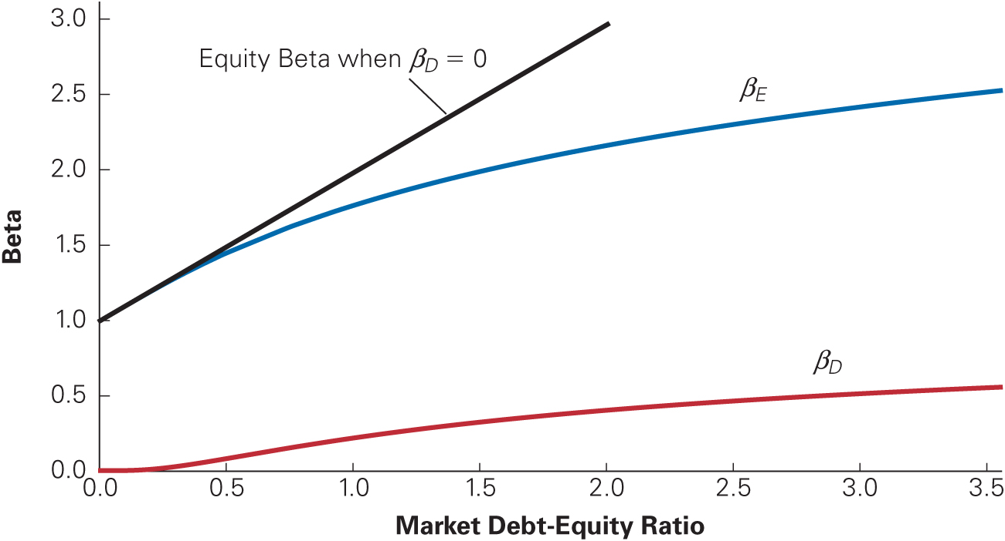
Figure 21.9 Beta of Debt and Equity
r_{f} = 3%
σ_{A}= 30%
T = 5 years

Slide 74
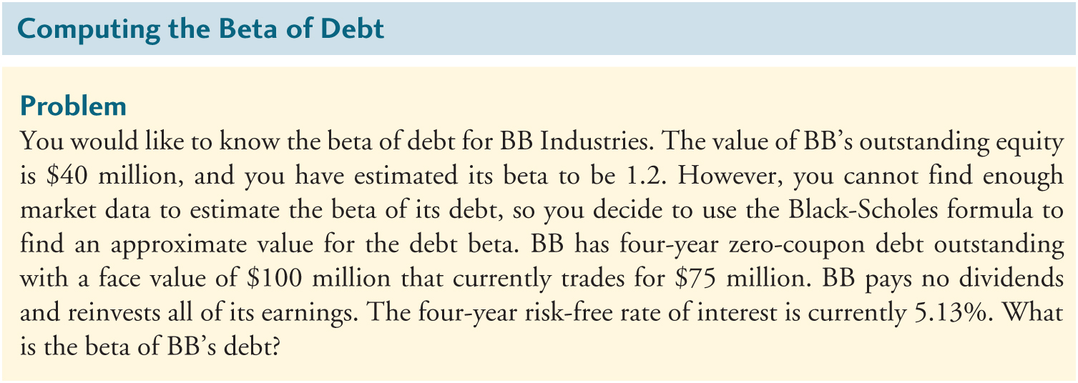
Textbook Example 21.10

Slide 75
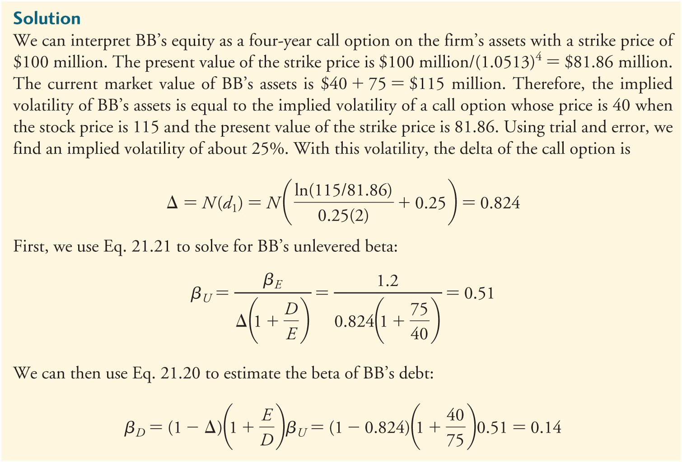
Textbook Example 21.10 (cont'd)

Slide 76
Agency Costs of Debt
Leverage creates an asset substitution problem (switch safe assets for risky ones) because the value of the equity call option increases with the firm’s volatility.
For a call option Δ <1
Equity holders gain less than $1 for each $1 increase in asset value reducing their incentive to invest.
Debt overhang/underinvestment problem

Slide 77
Textbook Example 21.11

Slide 78
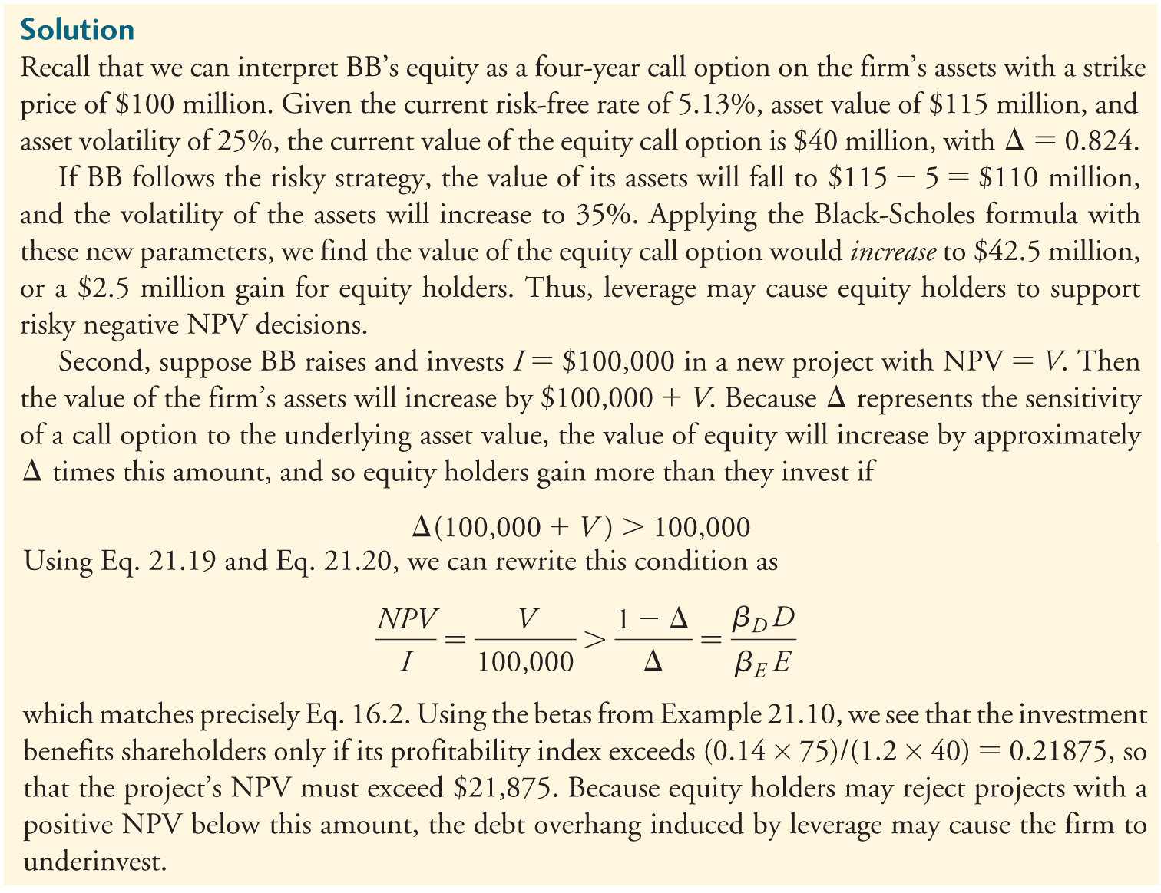
Textbook Example 21.11 (cont’d)

Slide 79
Discussion Question Week 4
Alan Bond was both a hero and a villain to the Australian public. A hero, because he financed the boat that won the Americas Cup, which had been unwinnable for over 130 years and a villain because he was jailed for fraud. His company, Bond Corporation, collapsed in 1991 owing billions of dollars.
In 1988 Bond Corporation had reported profits of the order of $200 million from property sales, but the sales were subsequently claimed to be a sham. One of these transactions involved the sale of a share in land north of Rome. Bond Corporation received $110 million for this sale and reported a profit of $74 million on the transaction. It was subsequently discovered that, as part of the deal, the buyer had received a free put option on the land that they had purchased. The option was written by Bond Corporation and had an exercise price of $110 million.
It was also discovered that Bond had purchased a call option, written by the buyer of the land. The exercise price was $110 million and the call premium was $20 million.
If the land originally cost $36 million did Bond Corporation really make a profit of $74 million? Why was it subsequently claimed that the transaction not really a sale? If it was not a sale, what was it? (Hint: Think about put call parity.)

Slide 80
Chapter Quiz
What is the key assumption of the binomial option pricing model?
What are the key assumptions of the Black-Scholes option pricing model?
What is the implied volatility of a stock?
What are risk-neutral probabilities, and how do they relate to valuing options?
How is the beta of a call option related to the beta of the underlying stock?
How can one estimate the beta of debt?

