Slide 1
BAFI1042 - Investment
Topic 5: Market Efficiency and Technical Analysis

Slide 2
Reference
Reilly, Frank K. , Keith C. Brown and Sanford Leeds, Investment Analysis and Portfolio Management (11th Edition), Thomson South-Western, 2019.
Chapter 5
Slide 2

Slide 3
Learning Objectives
After studying this topic you should have a better understanding of:
How does technical analysis differs from fundamental analysis
The implication of market efficiency on technical analysis
Assumptions and advantages of technical analysis
Major challenges of technical analysis
The rational and different trading rules
The three price movements postulated in Dow Theory
Importance of volume and moving average lines

Slide 4
Efficient Capital Markets
An efficient capital market is one in which security prices adjust rapidly to the arrival of new information, which implies that the current prices of securities reflect all information about the security

Slide 5
Efficient Capital Markets
informationally efficient market:
A large number of competing profit-maximizing participants analyze and value securities, each independently of the others
New information regarding securities comes to the market in a random fashion
Profit-maximizing investors cause security prices to adjust rapidly to reflect the effect of new information

Slide 6
Efficient Capital Markets
Weak form---Current prices reflect all security-market historical information, including the historical sequence of prices, rates of return, trading volume data, and other market-generated information
Semi-strong form --- Current security prices reflect all public information, including market and non-market information
Strong form --- Stock prices fully reflect all information from public and private sources

Slide 7
Efficient Markets and Fundamental Analysis
Fundamental analysts believe that there is a basic intrinsic value for the aggregate stock market, various industries, or individual securities, and these values depend on underlying economic factors
EMH implies that examining only past economic events is not likely to lead to outperforming a buy-and-hold policy because the market adjusts rapidly to known economic events
Merely using historical data to estimate future values is not sufficient
You must estimate the relevant variables that cause long-run movements

Slide 8
Technical Analysis
Technical analysts see no need to study the multitude of economic, industry, and company variables to arrive at an estimate of future value because they believe that past price and volume movements or some other market series will signal future price movements
Technicians also believe that a change in the price trend may predict a forthcoming change in some fundamental variables, such as earnings and risk, before the change is perceived by most fundamental analysts

Slide 9
Underlying Assumptions of Technical Analysis
The market value of any good or service is determined solely by the interaction of supply and demand
Supply and demand are governed by numerous factors, both rational and irrational
Disregarding minor fluctuations, the prices for individual securities and the overall value of the market tend to move in trends, which persist for appreciable lengths of time

Slide 10
Underlying Assumptions of Technical Analysis
4. Prevailing trends change in reaction to shifts in supply and demand relationships. These shifts, no matter why they occur, can be detected sooner or later in the action of the market itself
See Exhibit 5.2
It shows the process wherein new information causes a decrease in the equilibrium price for a security but the price adjustment is not rapid

Slide 11
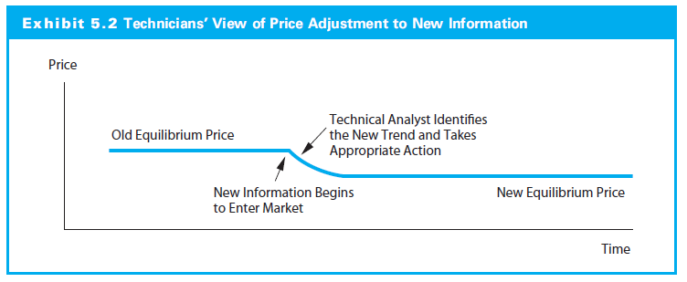
Exhibit 5.2

Slide 12
Advantages of Technical Analysis
Technical analysis is not heavily dependent on financial accounting statements. The technician contends that there are several major problems with accounting statements:
Lack information needed by security analysts
Accounting standards allow firms to select reporting procedures, resulting in difficulty comparing statements from two firms
Non-quantifiable factors do not show up in financial statements

Slide 13
Advantages of Technical Analysis
2. Fundamental analyst must process new information and quickly determine a new intrinsic value, but technical analyst merely has to recognize a movement to a new equilibrium
3. Technicians trade when a move to a new equilibrium is underway but a fundamental analyst finds undervalued securities that may not adjust their prices as quickly

Slide 14
Challenges to Technical Analysis
For Assumptions of Technical Analysis
Empirical tests of Efficient Market Hypothesis (EMH) show that prices do not move in trends
For Technical Trading Rules
The past may not be repeated
Patterns may become self-fulfilling prophecies
A successful rule will gain followers and become less successful
Rules require a great deal of subjective judgment

Slide 15
Technical Trading Rules & Indicators
The Rationale
A typical stock price cycle for the market or a stock goes through a peak and trough as well as trends
By analyzing the trend patterns (rising trend, flat trend, declining trend) and the change in trend, a technical analyst would be able to decide what trade is needed (Exhibit 5.3)

Slide 16
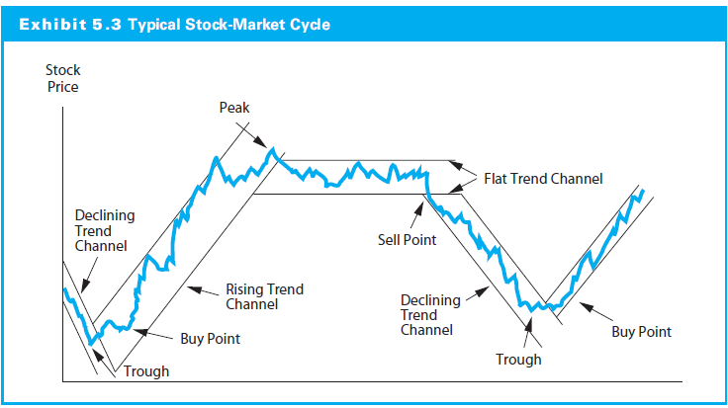
Exhibit 5.3

Slide 17
Technical Trading Rules & Indicators
Trading Rules
Stock Price and Volume Techniques
Contrary-Opinion Rules
Follow the Smart Money
Momentum Indicators

Slide 18
Stock Price and Volume Techniques
Importance of Volume
Technicians watch volume changes along with price movements as an indicator of changes in supply and demand
The technician looks for a price increase on heavy volume relative to the stock’s normal trading volume as an indication of bullish activity
Conversely, a price decline with heavy volume is considered bearish
Technicians also use a ratio of upside–downside volume as an indicator of short-term momentum for the aggregate stock market (>1;>1.75;<=0.75)

Slide 19
Stock Price and Volume Techniques
Support and Resistance Levels
A support level is the price range at which the technician would expect a substantial increase in the demand for a stock (following a significant increase in price)
A resistance level is the price range at which the technician would expect an increase in the supply of stock and a price reversal
It is also possible to envision a rising trend of support and resistance levels for a stock

Slide 20
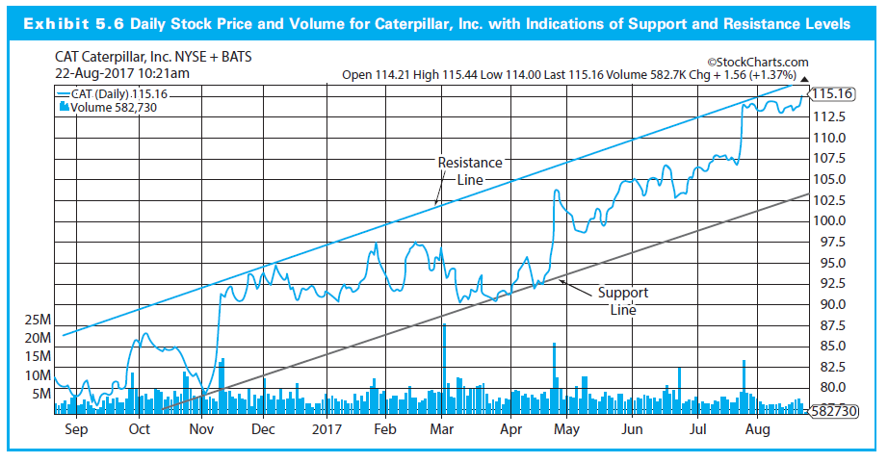
Stock Price and Volume Techniques

Slide 21
Stock Price and Volume Techniques
Moving Average (MA) Lines
MA lines are meant to reflect the overall trend for the price series
The shorter MA line (the 50-day versus 200-day) reflecting shorter trends
Daily price vs MA
50-day MA vs 200-day MA
If prices reverse and break through the moving-average line from below accompanied by heavy trading volume, most technicians would consider this a positive change; and vice verse
If the 50-day MA line crosses the 200-day MA line from below on good volume, this would be a bullish indicator --- changes in overall trend

Slide 22
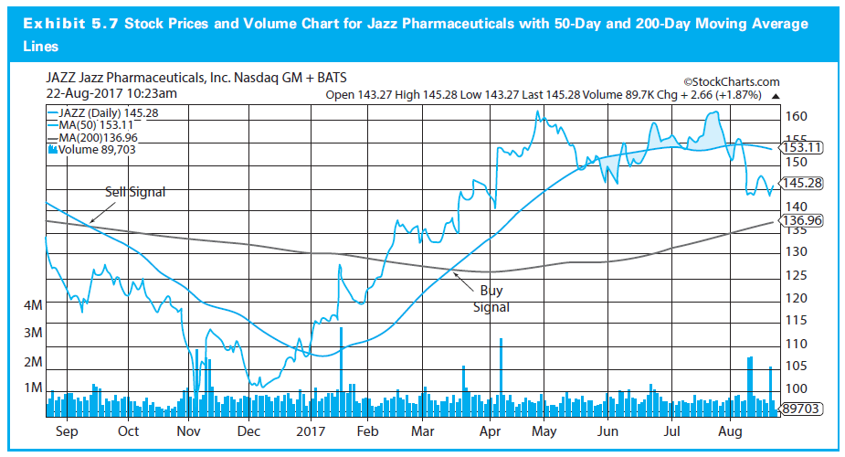
Exhibit 5.7

Slide 23
Stock Price and Volume Techniques
Relative Strength: performance relative to mkt
Relative Strength (RS) Ratio is defined as the price of an individual stock or an industry index divided by some stock market indexes like S&P 500
If this ratio increases over time, it would be considered a bullish sign
Bar Charting
Candlestick Charts
*Please read Topic 5 Relevant Notes (in Canvas module) for more detail

Slide 24
Stock Price and Volume Techniques
The Dow Theory
The oldest technical trading rule
Stock prices as moving in trends analogous to the movement of water
Three types of price movements over time
Major trends are like tides in the ocean
Intermediate trends resemble waves
Short-run movements are like ripples
Exhibit 5.5 shows the typical bullish pattern

Slide 25
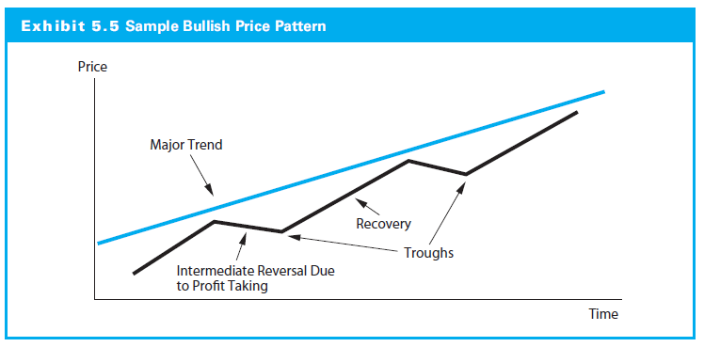
Exhibit 5.5

Slide 26
Contrary-Opinion Rules
Many analysts rely on rules developed from the premise that the majority of investors are wrong as the market approaches peaks and troughs
Technicians try to determine whether investors are strongly bullish or bearish and then trade in the opposite direction

Slide 27
Contrary-Opinion Rules
Mutual fund cash positions
Buy when the mutual fund cash position is high, sell when low
Assume that mutual fund managers are poor judges of market turning points
Credit balances in brokerage accounts
Buy when credit balances increase, sell when credit balances fall
Investment advisory opinions
Buy when advisory firms become more bearish

Slide 28
Contrary-Opinion Rules
Chicago Board Options Exchange (CBOE) put/call ratio
Buy when option purchasers are bearish (when the put/call ratio increases)
Readings of 0.6 and above are considered bullish, while readings of 0.3 and below are considered bearish signals
Futures traders bullish on stock index futures
Sell when speculators are bullish (survey):70%/30%

Slide 29
Follow the Smart Money
Confidence Index
Measures the yield spread between high-grade bonds and intermediate grade bonds
Declining (increasing) yield spreads increase (decrease) this index and are a bullish (bearish) indicator
T-Bill/Eurodollar Yield Spread
Decreases in this spread indicates greater confidence and is a bullish indicator
Debit Balances in Brokerage Accounts (Margin Debt)
Such balances represent buying on margin, which is assumed to be done by largely sophisticated investors
Increases are a bullish signal

Slide 30
Momentum Indicators
Breadth of market
Measures the number of issues increased relative to the number of issues declined each day
The advance–decline index is typically a cumulative index of net advances or net declines
See Exhibit 5.4
Stocks above their 200-day moving average
The market is considered to be overbought and subject to a negative correction when more than 80 percent of the stocks are trading above their 200-day moving average

Slide 31
Exhibit 5.4

Slide 32
Summary
Efficient market and implications
Assumptions and Advantages of TA
Challenges of TA
Four Trading Rules and their indicators
Contrary-Opinion Rules
Follow the Smart Money
Momentum Indicators
Stock Price and Volume Techniques
Price and volume techniques
Dow Theory
Support and Resistance level
Moving Average

