Slide 1
Essay Prep 1 Tutorial

Slide 2
Next 3 tutorials: Essay tutorials
This week
(19th – 23rd August)
Essay topic
Finding material for your essay
Expectations and marking criteria
Essay Prep 2 (26th – 30th August)
Selection, and report of evidence
Submission guidelines
Assignment assistance
Essay Prep 3 (2nd – 6th September)
More essay tips
Research interpretation and alternative explanations
IV-DV review
Notes:
IF you attend all your tutorials – it’s hard to fail. These tutorials will give you the essay structure and basic tips – tutorials after these will help you to practice the essay skills.

Slide 3
Deadlines
Quiz 1 open - 9:00, 20th August
close – 17:00, 23rd August
Draft introduction due (recommended)
Friday 6th September before 14:00
*This is your opportunity to get feedback from the person who will mark your final essay!
Final essay due (mandatory)
Friday 11th October before 14:00
Notes:
Write these down. These are important.
WARNING: computerised times – 1 minute late = 1 day penalty

Slide 4
Essay topic
Does brain training positively impact a variety of cognitive abilities?
Further essay topic information can be found under the Assessment Section on Blackboard. This includes important background information, essay topic and a required list of readings.

Slide 5
Essay topics
This is an argumentative essay.
You will:
Argue for or against a position using your evidence
NO fence sitting
Use empirical evidence to support the argument
Peer reviewed journal articles: specifically, ‘original research article’ or ‘experimental reports’.
In this assignment, the reading list is provided for you (all of which are experimental reports).
Notes:
Different types of essays: argumentative, persuasive, creative, critical
Webpage with different examples: http://essayinfo.com/essays/argumentative_essay.php#.UDXQGqD4J7I
“The function of an argumentative essay is to show that your assertion (opinion, theory, hypothesis) about some phenomenon or phenomena is correct or more truthful than others‘…. Argumentative writing is the act of forming reasons, making inductions, drawing conclusions, and applying them to the case in discussion; the operation of inferring propositions, not known or admitted as true, from facts or principles known, admitted, or proved to be true. It clearly explains the process of your reasoning from the known or assumed to the unknown. Without doing this you do not have an argument, you have only an assertion, an essay that is just your unsubstantiated opinion.”

Slide 6
What empirical evidence is not!
These are not considered empirical evidence.
Anecdotes: e.g. ‘all my male friends are doing engineering and all my female friends are doing arts…’
Opinions: e.g. ‘smokers are lazy people therefore exercise will not help their sleep..’
Bare facts without the support of studies: e.g. ‘95% of mathematics students at UQ are male..’
Notes:
You are not a journalist – this is NOT an opinion piece.
Feel free to add in ABS statistics or those you’ve gathered from wider reading to support your facts.

Slide 7
Finding full-text article
Where to look:
Reference list of key articles on the topic
Library catalogues and/ or databases, use a keyword search
Library website: www.library.uq.edu.au
Google Scholar: http://scholar.google.com.au/
Make sure you are logged in to the library website to access full text articles
DO NOT use internet references
SS&H library provides workshops on finding information – ask at the Library Help Desk for workshop times.
Notes:
Don’t pay for articles!
Show how to access full text using Library links & Google Scholar libraries.

Slide 8
Essay Structure and marks
Main sections of an essay (30 total marks):
Introduction (4/30)
Body (20/30)
Evidence (2 empirical studies)
Interpretation (of the above 2 empirical studies)
Conclusion (3/30)
Presentation (3/30)
Length = max 1500 words (+10% leeway)
Notes:
WORD COUNT: general rule of thumb is to divide word count by total marks, and ensure each section has approximately the right proportion of words.
Best papers are about 1200-1300 words → concise & clear

Slide 9
Essay Basics
Essay Title
Introduction
Evidence 1
Interpretation 1
Evidence 2
Interpretation 2
Conclusion
Notes:
This funnels shows how information goes from general to specific & then vice versa.

Slide 10
Introduction (4/30)
Your introduction is all about preparing the reader for what you are going to tell them in the body.
So…start at the beginning:
Provide a general intro to the topic
State your thesis with respect to the topic question
Summarise the evidence that will be used to support the thesis
Why is the thesis statement so important in your essay?
No fence-sitting!!
It should be very clear which side you are arguing: for or against!
i.e. “This essay will argue that…”
Notes:
There is an example later in the slides
Your intro should not be too long! Keep it short and simple.
5-6 sentences (General intro 2/3 sentences, thesis statement 1 sentence, evidence summaries 1 sentence each)

Slide 11
Hypothesis vs Thesis
Hypothesis | Thesis
A statement about the predicted relationship between the IVs and DVs. | A summary of your argument expressed in a sentence.
Developed when you conduct an experiment and are writing up the report. | Developed when you are writing an essay.
(Usually) developed before an experiment is conducted. | (Usually) developed after many studies have found similar results.
Notes:
Taken from: http://classweb.gmu.edu/rnanian/ThesisGuidelines.html
The thesis is the statement that the rest of the essay supports; a thesis never provides its own support. It makes no sense to say a thesis is poor because it is unsupported or lacks evidence; the support or evidence comes elsewhere. A thesis that supported itself would be self-evident — a fact — and could not then serve as the basis for an essay. Of course, an essay may be poor because the author never supports the thesis persuasively, but that is the problem of the essay as a whole, not the thesis itself.
Using Stroop example:
Hypo: Ps will read faster/slower under x condition.
Thesis: This paper will argue that reading is an automatic process.

Slide 12
Body - Evidence (10/30)
Describe two different pieces of empirical evidence, from different articles
Both article should come from allocated readings (see Blackboard)
It is not a requirement to include additional referencing materials on top of the two main evidence
Clear and accurate reporting of the evidence
Relevant
ONLY present evidence that best supports your thesis statement
Quality versus quantity (keep in mind your word count)
Notes:
Explain ways to structure the body – give them your preference for easier marking. Either
* write about the evidence from both your studies, then the interpretation from both.
OR…
* evidence from 1, interpretation from 1, evidence from 2, interpretation from 2.

Slide 13
Body - Evidence (10/30)
Describe each piece of empirical evidence in sufficient detail so the reader understands exactly what was done
Include enough detail so that the reader can understand:
Aim(s) of the study
IV(s)
Levels/conditions of IV(s)
DV(s)
Operational DV
Relevant participant details
The study’s procedure
The study’s results/conclusions (Be concise! 1-2 sentences. Statistics not required)
Notes:
Explain ways to structure the body – give them your preference for easier marking. Either
* write about the evidence from both your studies, then the interpretation from both.
OR…
* evidence from 1, interpretation from 1, evidence from 2, interpretation from 2.
CHERRY PICK EVIDENCE! You’ll never be allowed to do it again – so enjoy it!
This is almost like an annotated bibliography – cite only once at the start of the paragraph.

Slide 14
Body - Interpretation (10/30)
Critically evaluate the evidence
Discuss the strengths and limitations of EACH study
Report two strengths and two limitations of EACH study
Explain why these are strengths/limitations, why they are important, what effect this might have had on the study/findings?
i.e. “One limitation of the present study was _____, because of _____ and this may have had _____ effect on the results of the study.”
Things to consider (as a starting point):
Does the research actually address the research question?
What research method was used (i.e. experimental, survey, case study, etc) and was this appropriate?
Does the evidence support the researcher’s claims as they say it does?
Are there alternative explanations for the results?
Notes:
Emphasize that marks are given for strength AND limitation of BOTH studies. No need to be fancy about this.
Explain what critical evaluation is – spend time here (if you have it). But we will practice this in upcoming weeks. Explain what strengths and limitations mean – discuss in terms of study method (we want them to avoid sample size though!)
Give some examples (i.e. in terms of the stroop experiment conducted recently), ask them to come up with examples.

Slide 15
Body - Interpretation (10/30)
Clearly and logically apply the evidence in support of your argument
What impact do these strengths and weaknesses have on the thesis
Demonstrate how weaknesses don’t undermine your argument
On balance, does the evidence support your thesis? (hopefully yes!)
Show how the evidence supports your argument – link back to your thesis statement
Use your own words and ideas – restating the researchers’ conclusions is not enough!
Your Interpretation mark will be constrained by your Evidence mark
You can only interpret the evidence that you have already discussed!
Notes:
Demonstrating how weaknesses don’t undermine the argument is probably the most difficult part of this essay and something that many students don’t even attempt.
An example could be that although the presented weaknesses may over/underestimate the extent of the obtained effect, the direct of the results would not change and therefore the conclusions are still true.
We work on the interpretation section more in future weeks.

Slide 16
Conclusion (3/30)
Funnel your ideas back out (in a single paragraph)
Summarise the evidence and main ideas, demonstrating clearly how they supported your argument.
Relate it back to your intentions stated in the introduction – restate your thesis!
Include a general concluding comment (specific directions for future research OR ideas for addressing previously identified limitations)
Do not claim to have demonstrated more than your evidence can support.
Do not introduce new material
Notes:
Think of the funnel! Remember to include a reference back to the general topic.

Slide 17
Presentation & Writing (3/30)
Overall essay structure
2.0 line spacing throughout
Includes Intro/ Body/ Conclusion
Logical & easy to understand
12-point Arial or Times New Roman font
Spelling, grammar, APA referencing
No headings between paragraphs
No use of quotations (use your own words)
Include an APA-formatted reference list
Length = max 1500 words (+10%)
Include ‘in-text’ references but not the ‘References’ list
Marker will stop reading after the absolute maximum (1500 + 10%)
Notes:
Follow the rules for 1020 with your 1020 essay and the 1030 rules for 1030 essays…
You will lose marks for going over-length. If you are at 1600 words – you need to be more concise (best papers are 1200-1300).
(We don’t want them going over 1500, so warn them about length – I usually have 2 or so students each semester who go over the word limit and I can’t read their entire conclusion). More is not better, it actually makes it harder to mark.
No minimum word count.
Many quotations is a mark of poor academic writing – be wary of TurnItIn (read ECP). There should be no reason that they need to use quotations , encourage them to always explain things in their own words

Slide 18
APA referencing
“References” is the only word in the heading.
It should be centred in 12pt font.
References should be in alphabetically order by surname- not numbered nor bullet pointed
Hanging indent
In-text citations
No need to reference every sentence, use good judgment
See:
http://www.library.uq.edu.au/training/citation/apa_6.pdf
Notes:
Except for ‘evidence’ paragraphs – ensure you use accurate and adequate quotations. If you are unsure about this, read more papers! These are included in your word count!
Most HD papers do have >2 references; these are usually in the introduction (to help with definitions and wider concepts) and occasionally in the interpretation – to explain what alternative methods might be used. However, these references (especially for the intro) do NOT need to be peer-reviewed (just need to be from credible sources) – feel free to use ABS stats or the textbook.

Slide 19
Before 6th September…
If you would like to be on track for your assignment and get feedback on your introduction paragraph you need to:
SUBMIT A DRAFT PARAGRAPH BY 2pm
Friday 6th September via Turnitin
Notes:
***This is optional, but highly recommended!***
Less than 1 page – Introduction paragraph ONLY
Chance to check if your references are peer-reviewed.
Can check yourself using Ulrichsweb (show)

Slide 20
More example of an Introduction paragraph…
Include at least an attempt of each component of the Introduction:
General Intro (should be concise, and be appropriately referenced; e.g., “The question of whether Lady Gaga is better than Katy Perry has been shown to have implications for pop music fans (DeRogatis, 2009) and record company executives (Mottola, 2010)…”)
Thesis statement (Must pick a side, phrase it clearly; e.g. “This essay will argue that Lady Gaga makes better music than Katy Perry....”)
Overview of evidence (Concise summary of the results for each study, with in text citations; e.g., “, and Hudson (2009), who found that…”) Evidence for this argument can be seen in studies by Germanotta (2010), who found that listeners played Lady Gaga’s music a mean of 12dB louder

Slide 21
Tips for the Draft Introduction
Include any references you intend on using in your essay at the end of the paragraph (like you would at the end of your essay)
Just submit the best you can at this stage – remember, it is just a draft ☺
Notes:
They can also email you to confirm that the second piece of evidence they choose is empirical evidence from a peer-reviewed journal (not whether it would suit their argument)

Slide 22
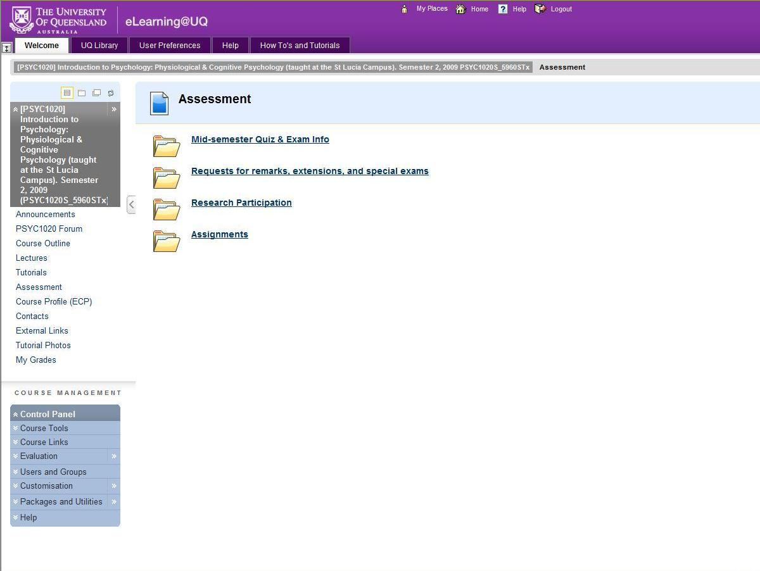
…and then on Assignments
You can access Turnitin by clicking on Assessment…
Notes:
(skim through these slides)

Slide 23
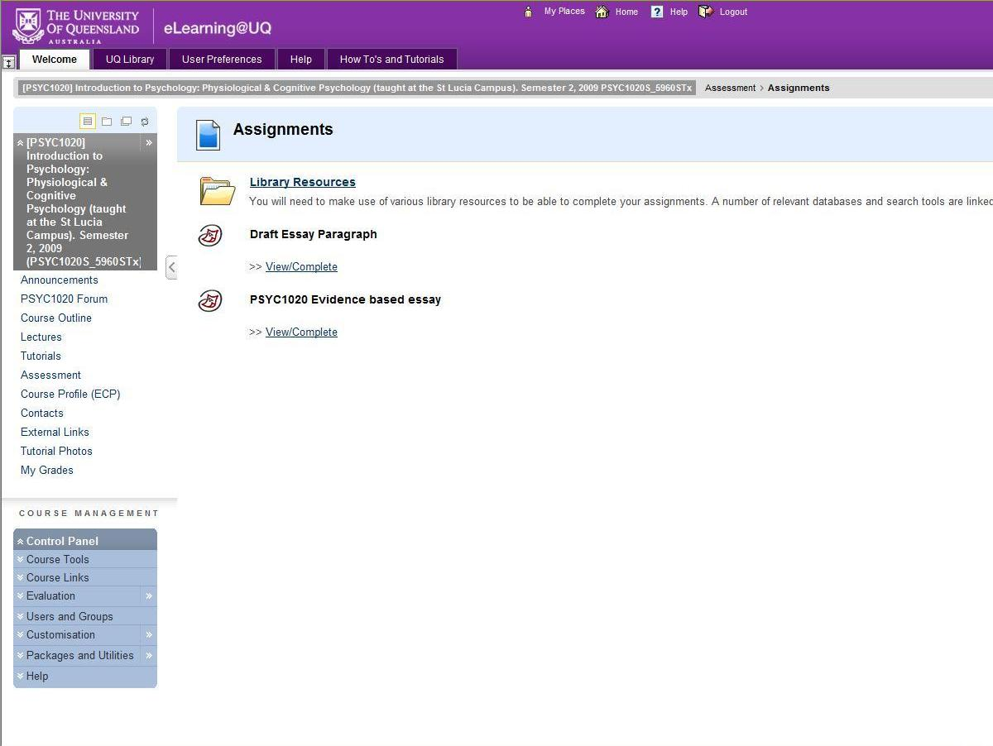
Then click on View/Complete to enter Turnitin

Slide 24
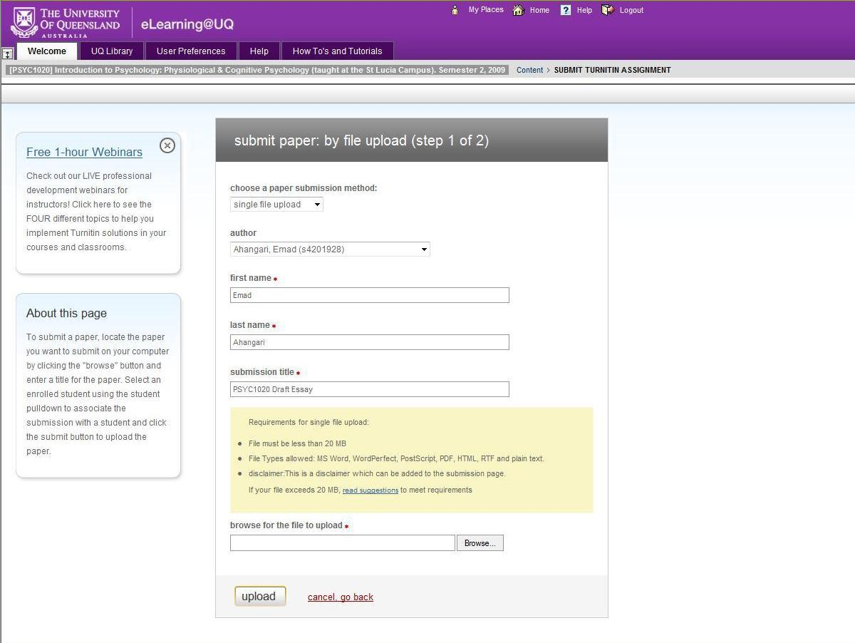
Choose your name from the drop down list, the first and last name should be automatically entered
Type in a submission title
(e.g. “PSYC1020 draft essay paragraph”)
Then click on Browse

Slide 25
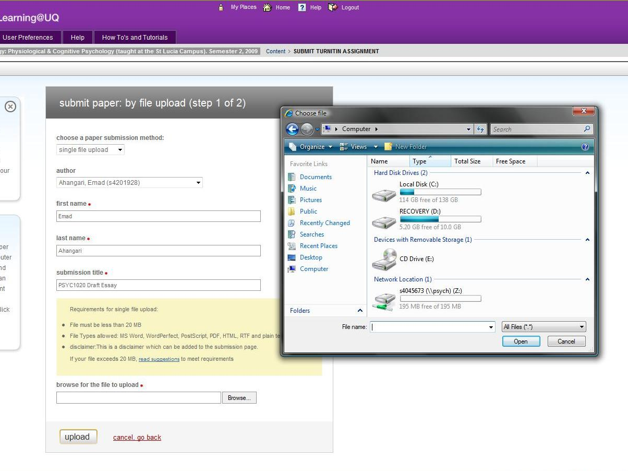
Look for where the file for your completed assignment is saved.
Select it, and then click ‘Open’.

Slide 26
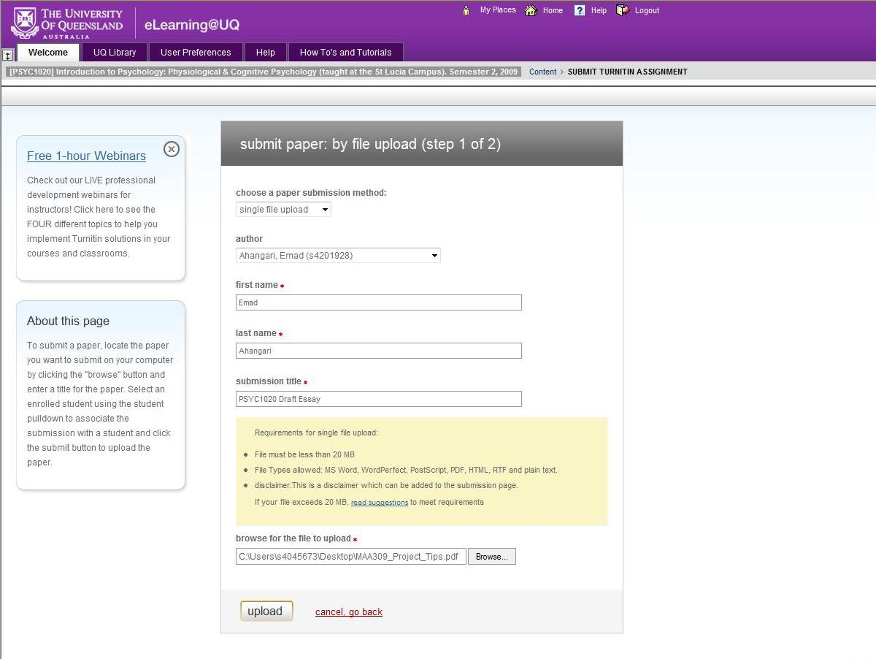
Check that you have the correct details and file...
...then click ‘upload’

Slide 27
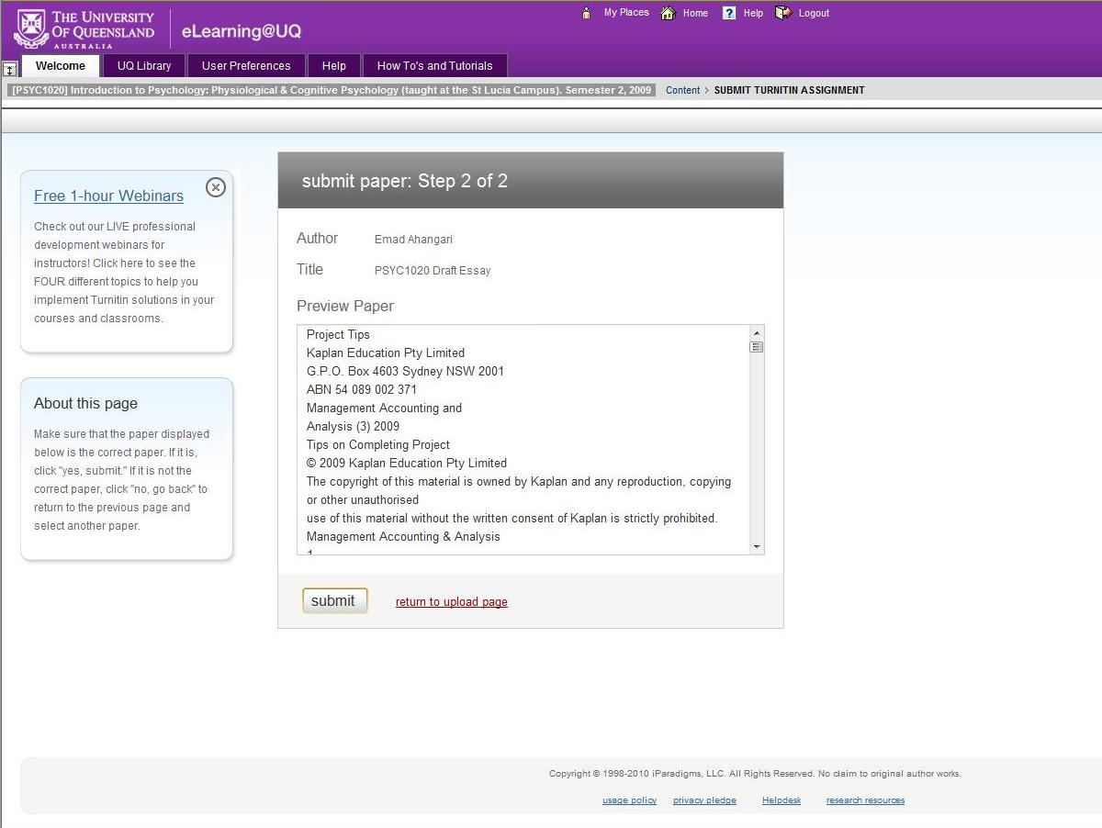
This is a text preview page, check again that you upload the correct paper
If you have uploaded a wrong paper, click on ‘return to upload page’ and upload the correct file
Then click ‘submit’
Notes:
CHECK!!

Slide 28
Last of all…
It will be displayed on the screen that your submission is successful. A copy of a submission receipt will also be sent to your student email account.
Save the receipt, as this is proof of your completed submission.
Notes:
Proof is important!

Slide 29
Plagiarism and Collusion
DO NOT DO IT!
Seriously.
Turnitin will detect it.
Very serious academic offence.
When you are studying, never copy and paste without noting where you copy from.
Put it into your own words – also, if you do that it will look like you actually understand what you’re writing!
Be very careful studying with friends/emailing drafts.
DO read pages 20-22 of your course outline (see “Policies & guidelines” link in the ECP for full policies on plagiarism).
Notes:
There is no reason to email a friend a draft of your essay – EVER.
If you want to check each other’s paper – use different references, print them out, go to coffee (mark suggestions on the paper), swap papers back. It’s hard to collude by accident that way.

Slide 30
Assignment assistance
Student Support Services
visit the Student Union Area
School of Psychology Student Support Tutors
Access webpage for available consultation hours and online booking
https://psychology.uq.edu.au/current-students/psychology-student-support-tutors
Particularly useful for students with English as a second language
You MUST enquire about appointments at least 10 days prior to the assignment due date
Notes:
PSST can read entire drafts – make sure you take the criteria sheet with you though!

Slide 31
Extension procedures
Applications for extensions must be submitted BEFORE the due date.
Online submission link can be found in ECP access via Blackboard
Applications will only be accepted after the due date in exceptional cases.

Slide 32
Next week…
Essay Prep 2 – selecting, reporting and interpreting the evidence
Don’t forget to take your Essay Criteria!
Notes:
32

