Slide 1
The Analysis of Afterpay Touch Group Ltd. in UK
Group 1: Kako Tim Ellie Jessie Ivy

Slide 2
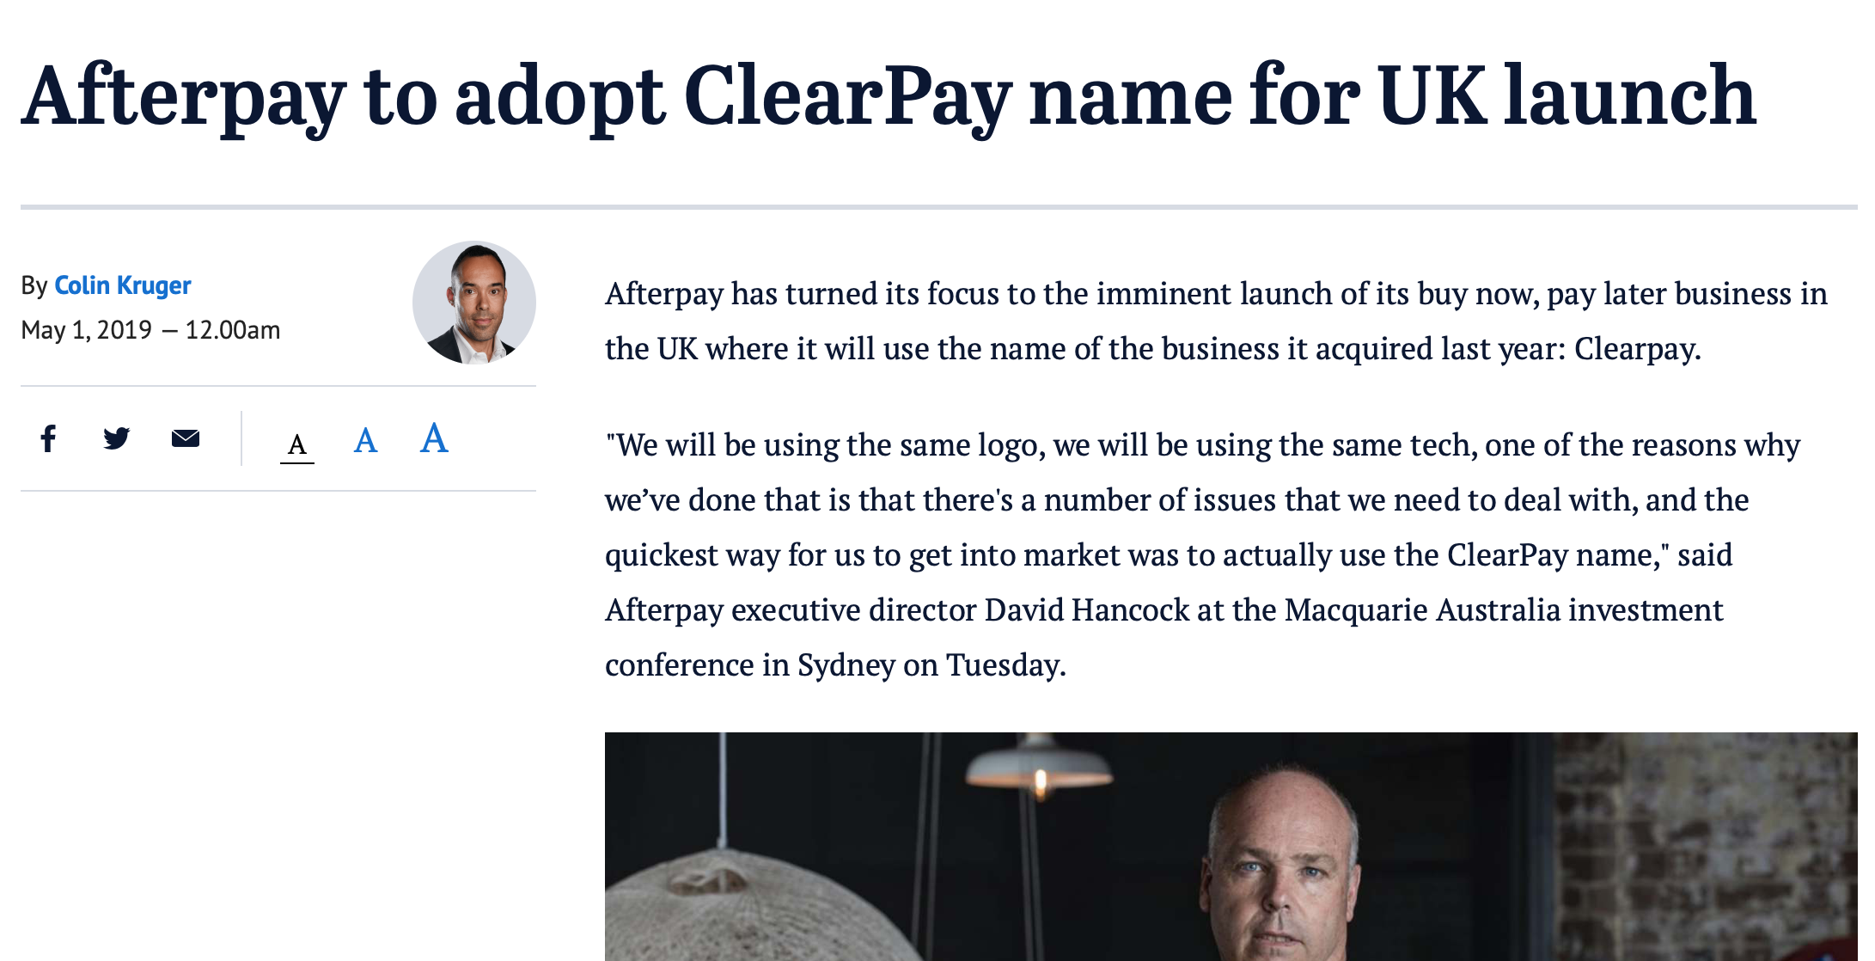
Introduction
About the News Story
New market: UK
$130 billion online market
Australia
$ 30 billion online market
(Kruger, 2019)

Slide 3
1
Company overview
2
SWOT Analysis
CONTENT
3
PEST Analysis
Porter’s Five Forces
4
Conclusion
5

Slide 4
01
PART
Company Overview

Slide 5
Company Overview
Afterpay Touch Group Ltd
公司简介
Afterpay
Buy now, receive now, pay later
Touch
Digital payment business that serves telecommunications, health and retail sectors
(Market Index, 2019).

Slide 6
02
PART
SWOT Analysis

Slide 7
SWOT
Strengths
Weaknesses
Strong distribution network
liquidity problems
(Afterpay, 2019b)
Active merchants of 32,300 at end of FY19, up 101%, and 35,300 currently
（Afterpay，2019a）
Limited usage scenario
High level of customer satisfaction

Slide 8
03
PART
PEST Analysis

Slide 9
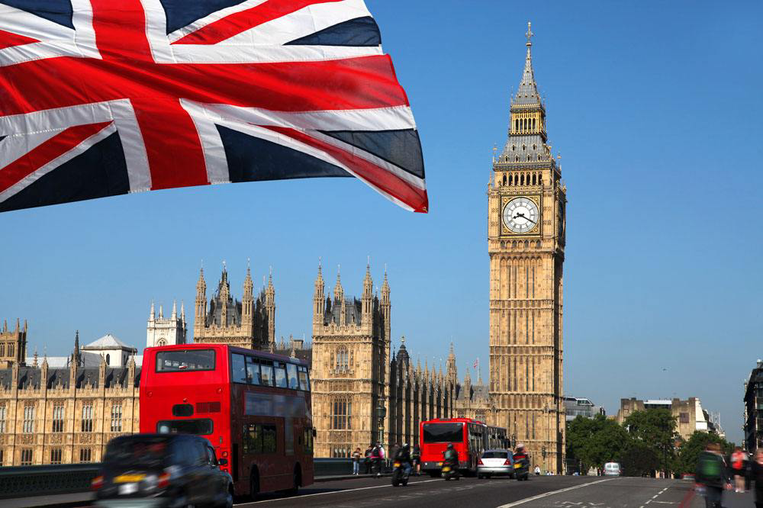
UK—Political
constitutional monarchy
runs under the parliamentary system
United Kingdom
Positive
Negative
Relatively ‘fair’ country, with the public having a large influence on the inner-workings
Proactive government
Politically stable
Split into national and local administrations
Some well-hidden corruption
Uncertainty in whether or not to stay in the EU, or leave (Brexit)

Slide 10
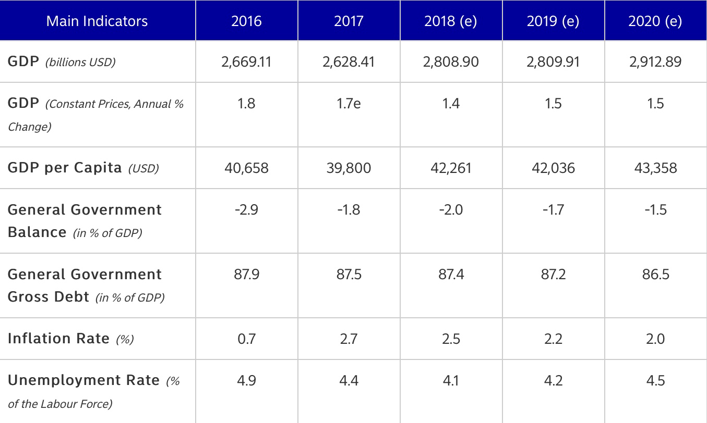
UK—Economic
Major indicator
5th highest GDP in the world
Large population allowing for even small markets to be profitable
Diversified economy with both large public and private sectors
Free market
Increasing Foreign Direct Investment

Slide 11
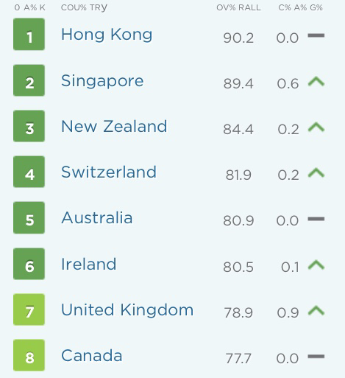
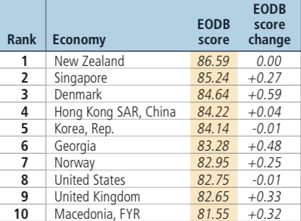
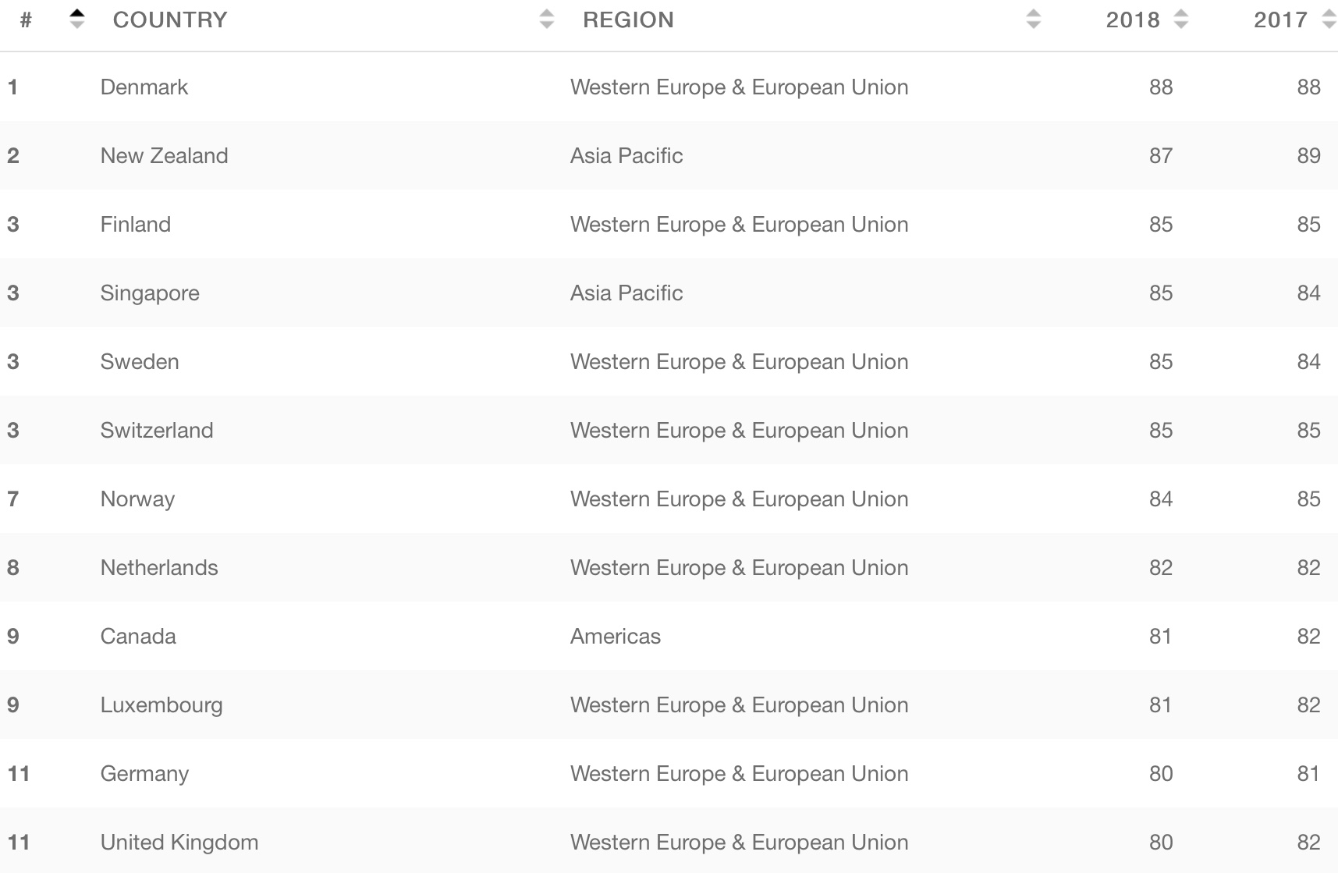
UK—Economic
UK
Index of Economic Freedom
Ease of doing business
Corruption perceptions index

Slide 12
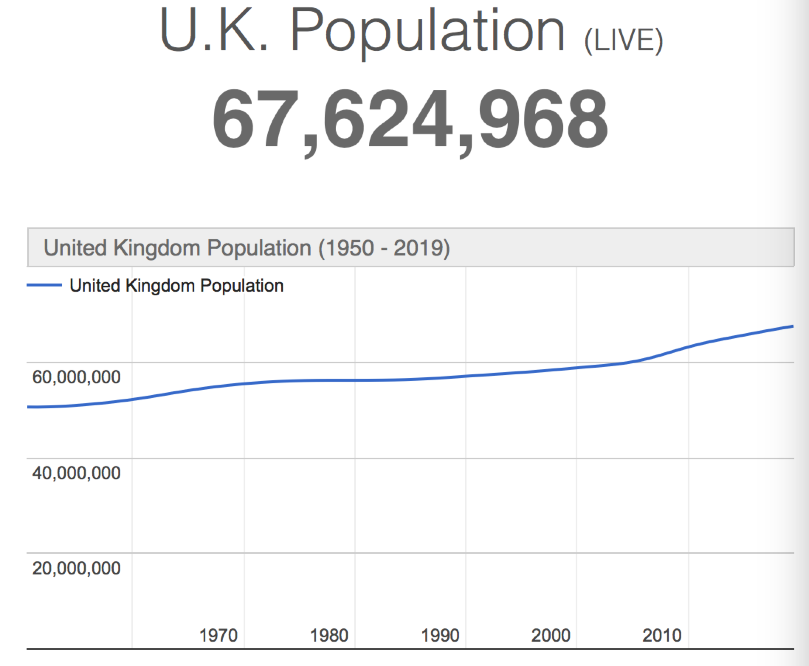
UK—Social
UK
Demographic
82.9 % of the population is urban
2020 Population: 25-54 years 39.8% (“U.K. Population” , 2019)
middle class with comfortable life and a secondary or tertiary education ("British Culture - Core Concepts", 2019)
Culture
a delicate and high-quality culture
various regional characteristics — a threat

Slide 13
UK—Technology
UK
an Alan Turing Institute to drive "big data" education
——"Turing institute to cash in on UK’s big data bonanza”(2014)

Slide 14
04
PART
Porter’s Five
Forces Analysis

Slide 15
Porter’s Five Forces analysis
Life cycle stage is mature (IBISWorld, 2019)
high
Rivalry among existing competitors
low
low
Threat of new entrants
Bargaining power of suppliers
low
medium
Bargaining power of buyers
Threat of substitutes
The industry in new market is attractive.

Slide 16
Porter’s Five Forces analysis
Threat of new entrants
Bargaining power of Buyers
The financial industry requires economic of scales
Initial capital investment is high
Strict government policy
New entrants are easy to access distribution network.
Buyer have less number of firms can choose.
Product differentiation in this industry is high.
Income of buyers is low.
Switching cost is low.
Bargaining power of suppliers
Afterpay announced a proposed merger with a software company called Touchcorp (Swan,2017).

Slide 17
Porter’s Five Forces analysis
Competitive rivalry
Fixed cost is high.
It is hard to get out of this business.
Switching cost is low.
The financial industry is growing.
Each firm’s products is highly differentiate.
Main competitors: zip pay/humm/openpay/Brighte/criditLine/Once/Paypal.
Threat of substitutes
Few substitutes available. Credit card (Barry,2019).
Some substitutes with higher price (Barry,2019)

Slide 18
05
PART
Conclusion

Slide 19
Conclusion
Afterpay has a positive prospect in the UK market.
Various Cultures
Competitor
Putting different ads
Build its own competitive advantages.
Provide multi-currency services.

Slide 20
References
Barry. (2019). Compare Interest-free Finance Providers. Retrieved from http://file://localhost/Users/ivy/Zotero/storage/ZDU5VH9C/interest-free-finance.html
British Culture - Core Concepts. (2019). Retrieved from https://culturalatlas.sbs.com.au/british-culture/british-culture-core-concepts
Eyers, J. (2019, April 16). Afterpay CEO Says Bring on the Competition. The Australian Financial Review. Retrieved from http://search.proquest.com/docview/2209595714/
IBISWorld. (2019). Industry at a Glance. Retrieved from http://clients1.ibisworld.com.au.ezproxy1.library.usyd.edu.au/reports/au/industry/ataglance.aspx?entid=1740
Kruger, C. (2019). Afterpay to Adopt ClearPay Name for UK Launch. Retrieved 6 October 2019, from https://www.smh.com.au/business/companies/afterpay-to-adopt-clearpay-name-for-uk-launch-20190430-p51iix.html
Market Index. (2019). Afterpay Touch. Retrieved October 8, 2019, from https://www.marketindex.com.au/asx/apt
PESTLE Analysis.(n.d.). An Example PEST Analysis of The UK. Retrieved from https://pestleanalysis.com/pest-analysis-of-the-uk/amp/
Santander.(2019). United Kingdom: Economic and Political Outline. Retrieved from https://en.portal.santandertrade.com/analyse-markets/united-kingdom/economic-political-outline
Swan, D. (2017, February 24). Touchcorp, Afterpay Merger Worth $500m. The Australian (National, Australia).
Turing Institute to Cash in on UK’s Big Data Bonanza. (2014). Electronics Weekly, (2582).
U.K. Population (2019) -Worldometers. (2019). Retrieved from https://www.worldometers.info/world-population/uk-population/
http://news.mtime.com/2019/05/21/1592131.html
Notes:
David Swan. (2017, February 24). Touchcorp, Afterpay merger worth $500m.(Business). The Australian (National, Australia).
Eyers, J. (2019, April 16). Afterpay CEO says bring on the competition. The Australian Financial Review. Retrieved from http://search.proquest.com/docview/2209595714/
Barry. (2019). Compare interest-free finance providers. Retrieved from http://file://localhost/Users/ivy/Zotero/storage/ZDU5VH9C/interest-free-finance.html
IBISWorld. (2019). Industry at a Glance Retrieved from http://clients1.ibisworld.com.au.ezproxy1.library.usyd.edu.au/reports/au/industry/ataglance.aspx?entid=1740

Slide 21
THANK YOU

